Slide 1
6200 Source Head
Components Assembly
Prepare by: SAMUEL

Slide 2
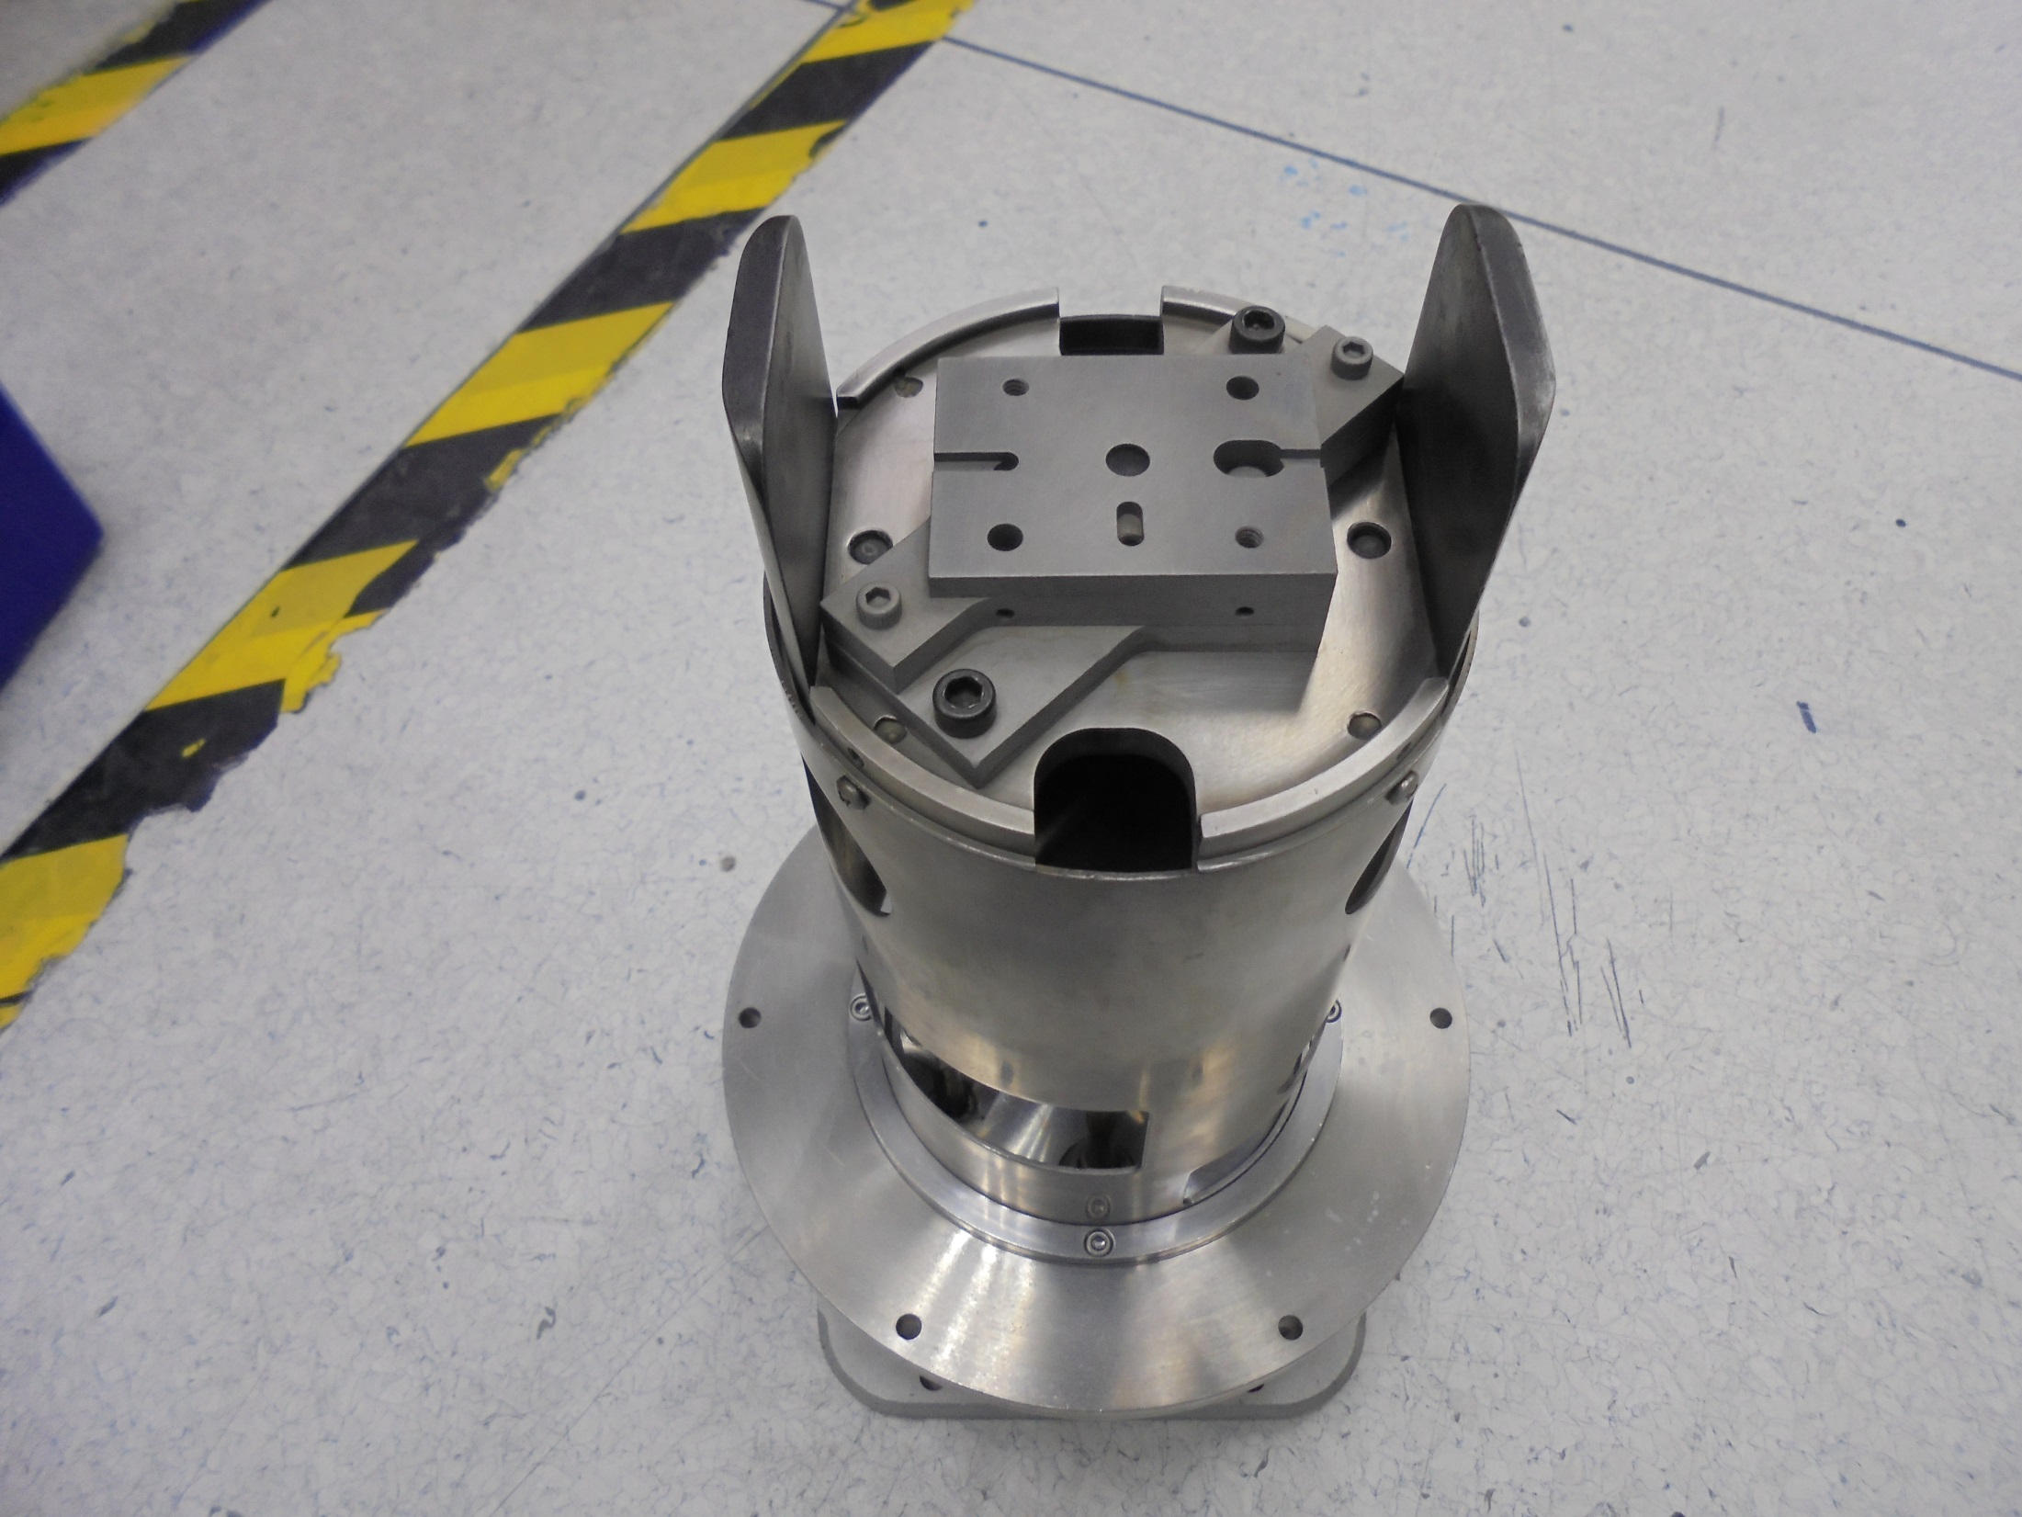

Slide 3
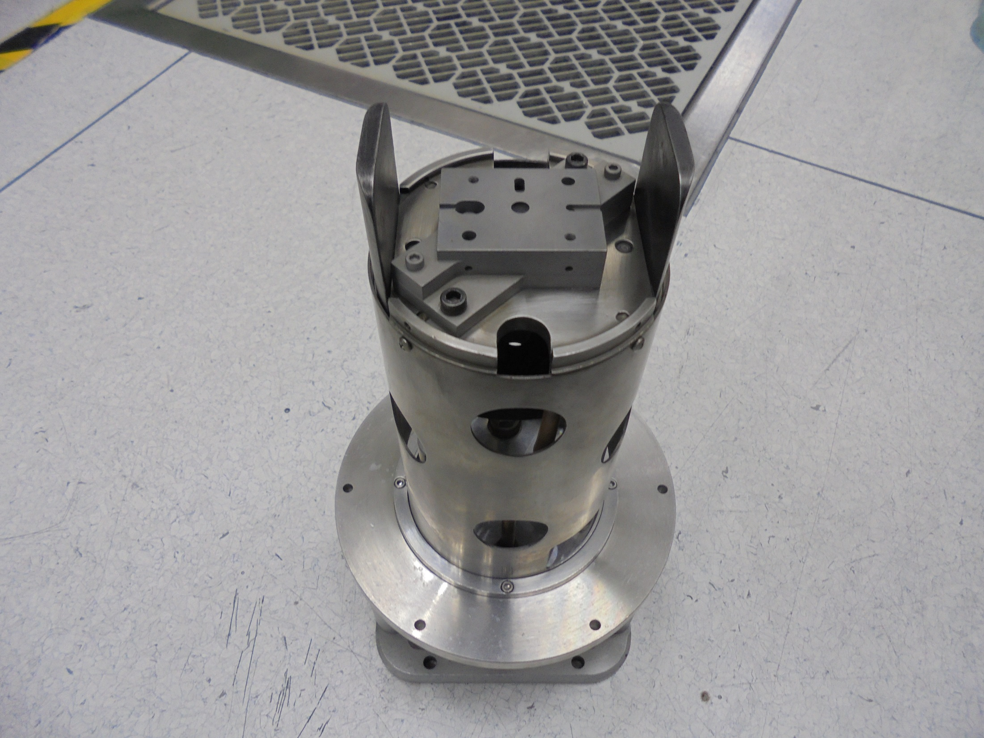

Slide 4
Alignment Tools

Slide 5
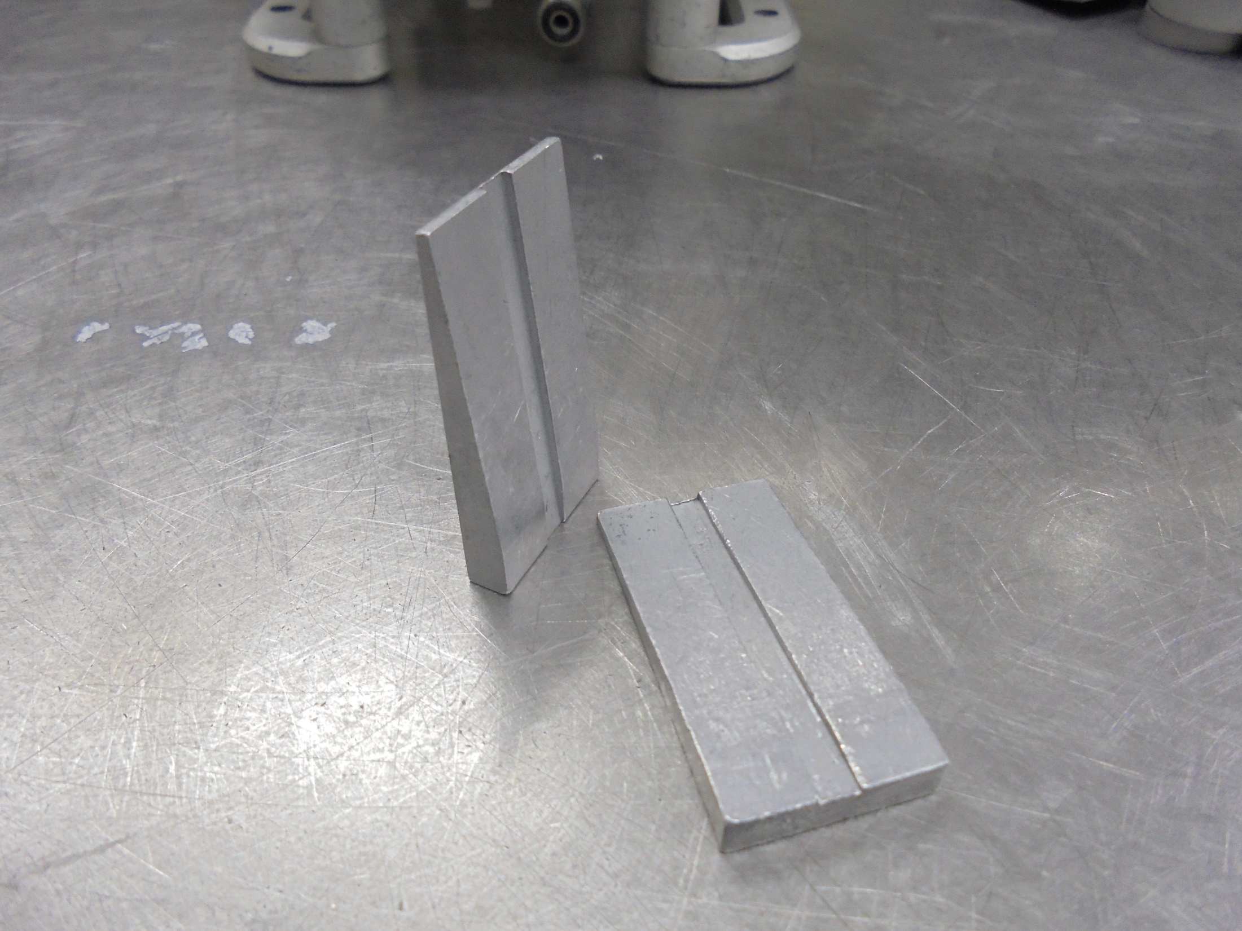
ARC CHAMBER ALIGNMENT JIGS

Slide 6
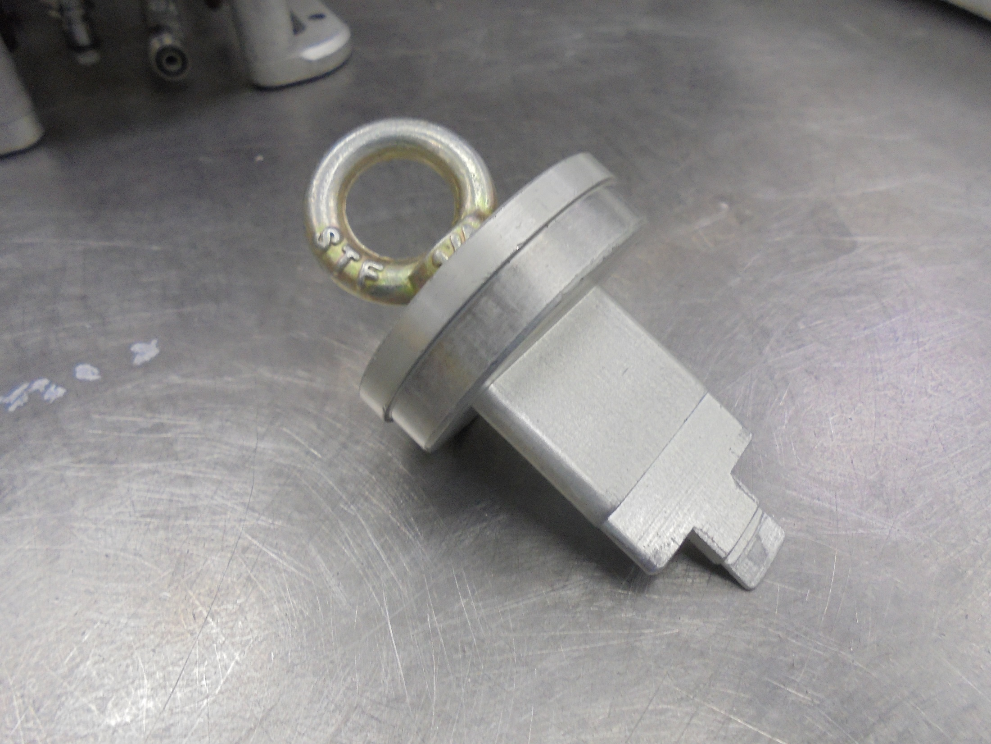
EXTRACTION ALIGNMENT JIG

Slide 7
Consumable Parts

Slide 8
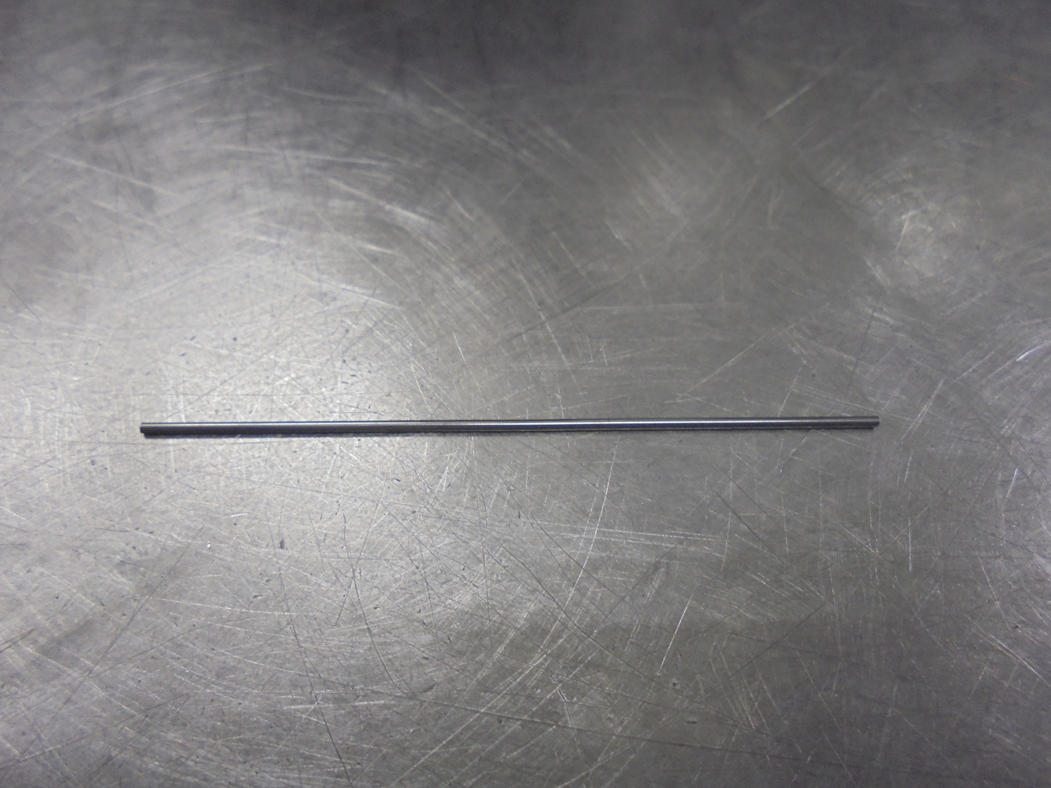
FILAMENT 1.1mm

Slide 9
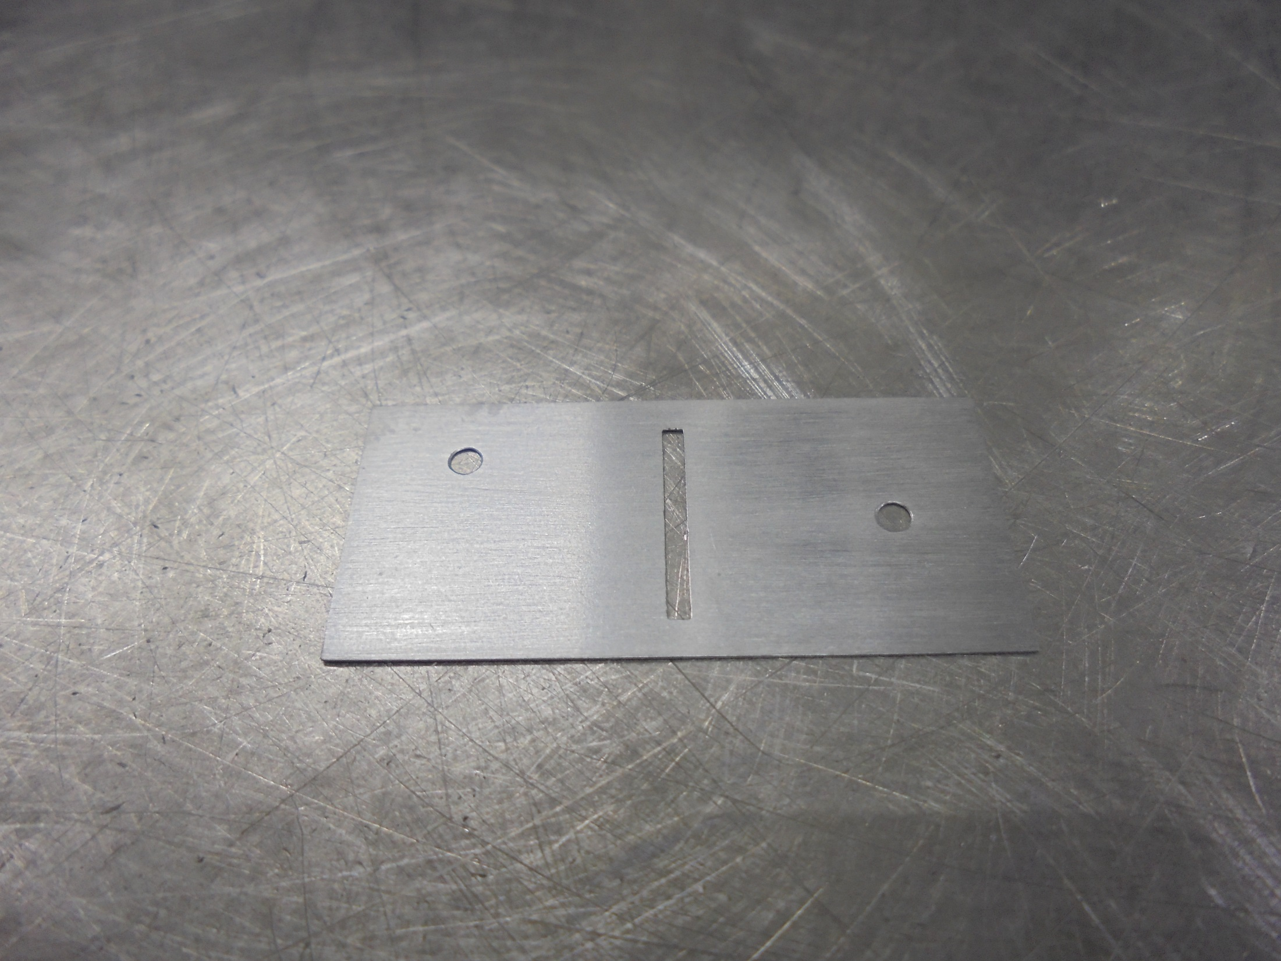
EMISSIVE INSERT

Slide 10
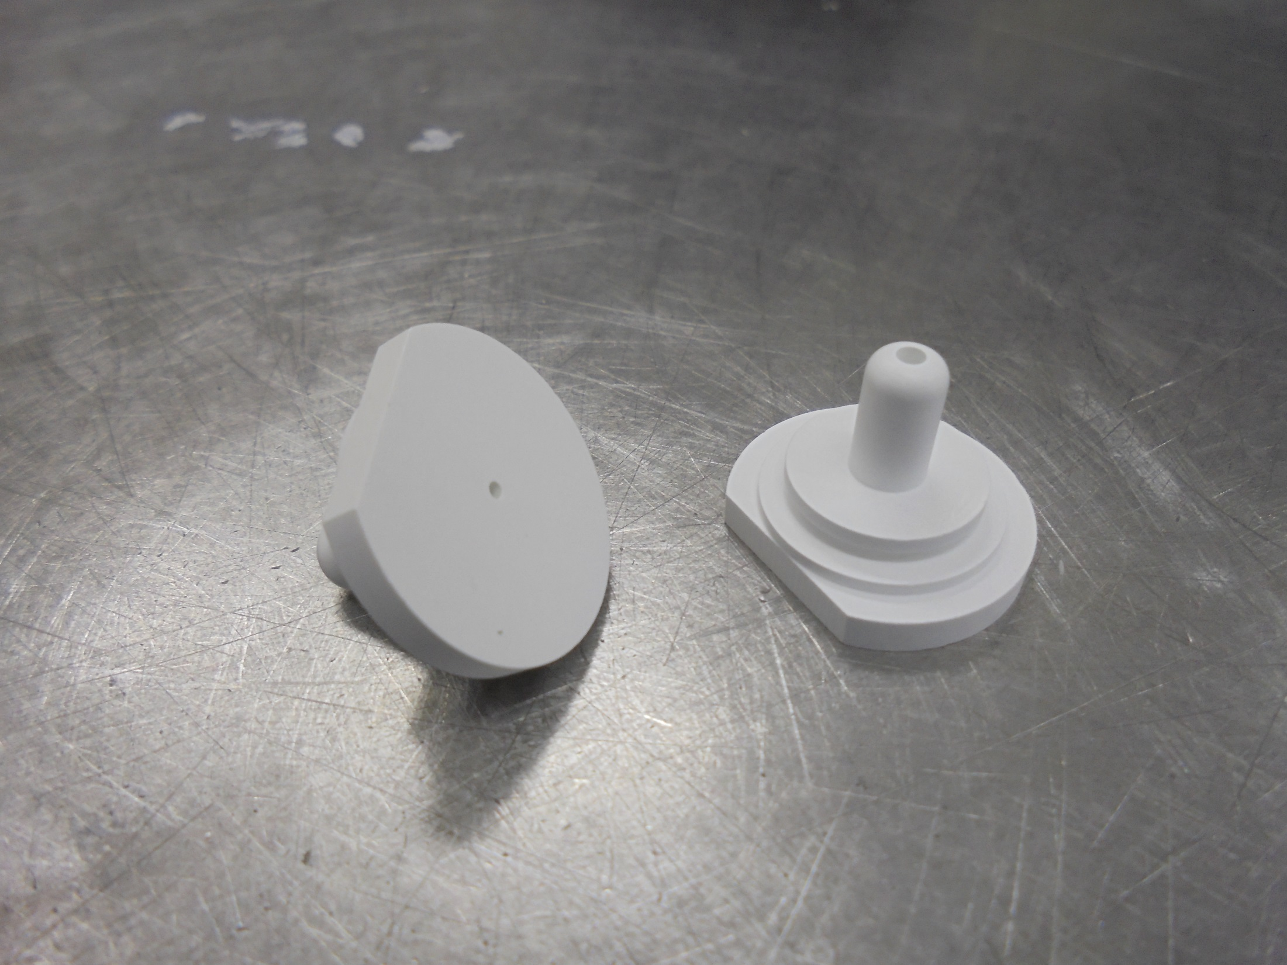
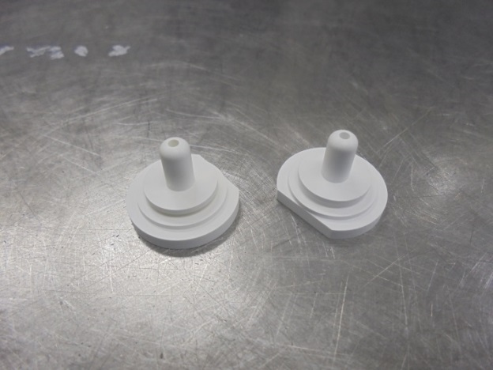
FILAMENT INSULATOR

Slide 11
Assembly:

Slide 12
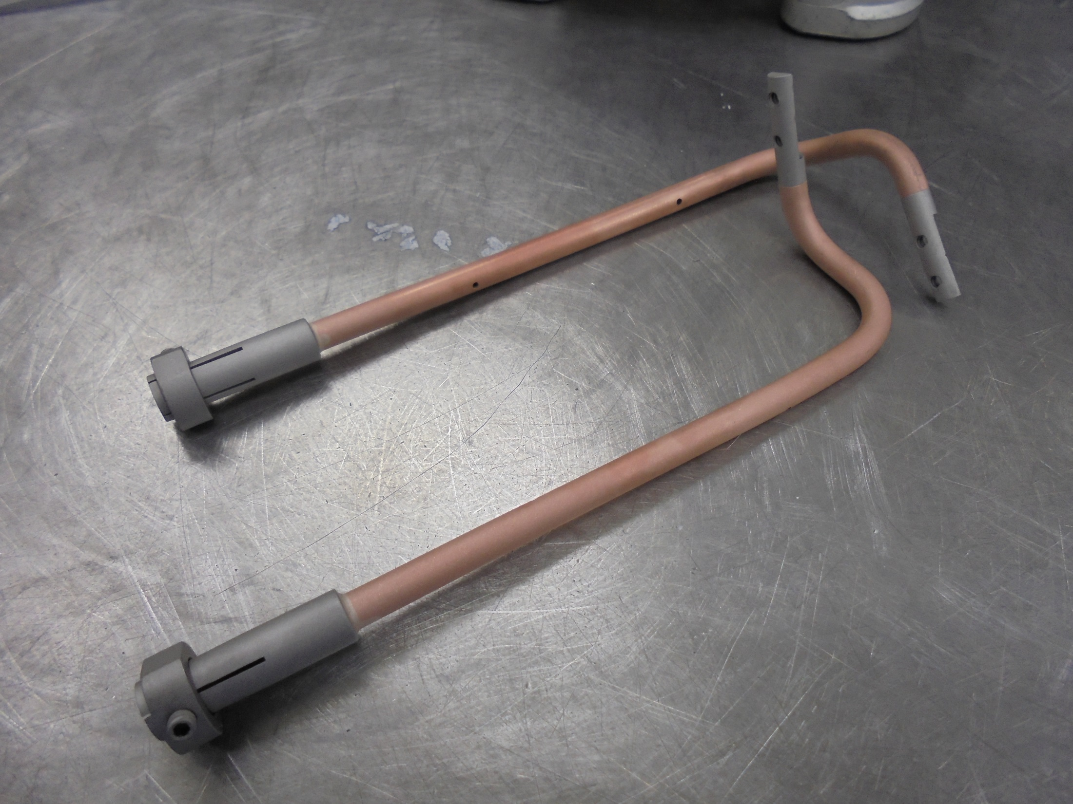
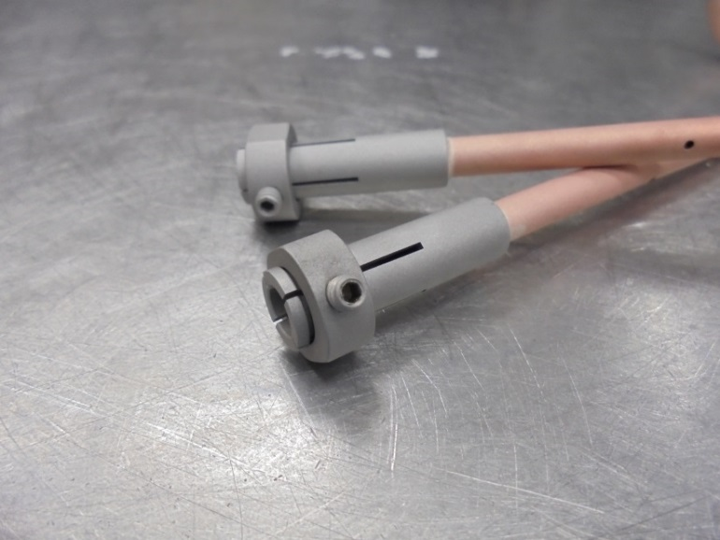
FILAMENT COPPER ROD
screw lock

Slide 13
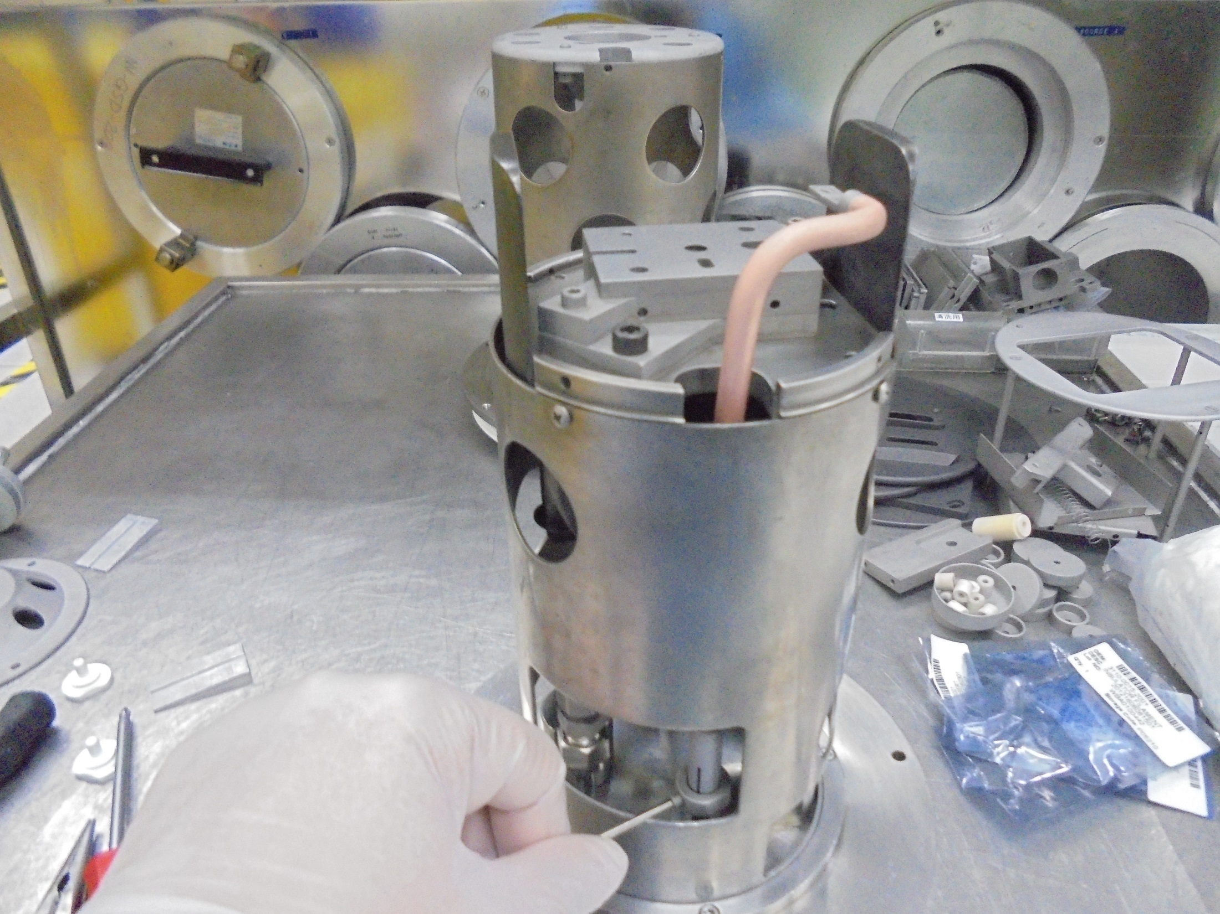
Insert Here
Secure Screw

Slide 14
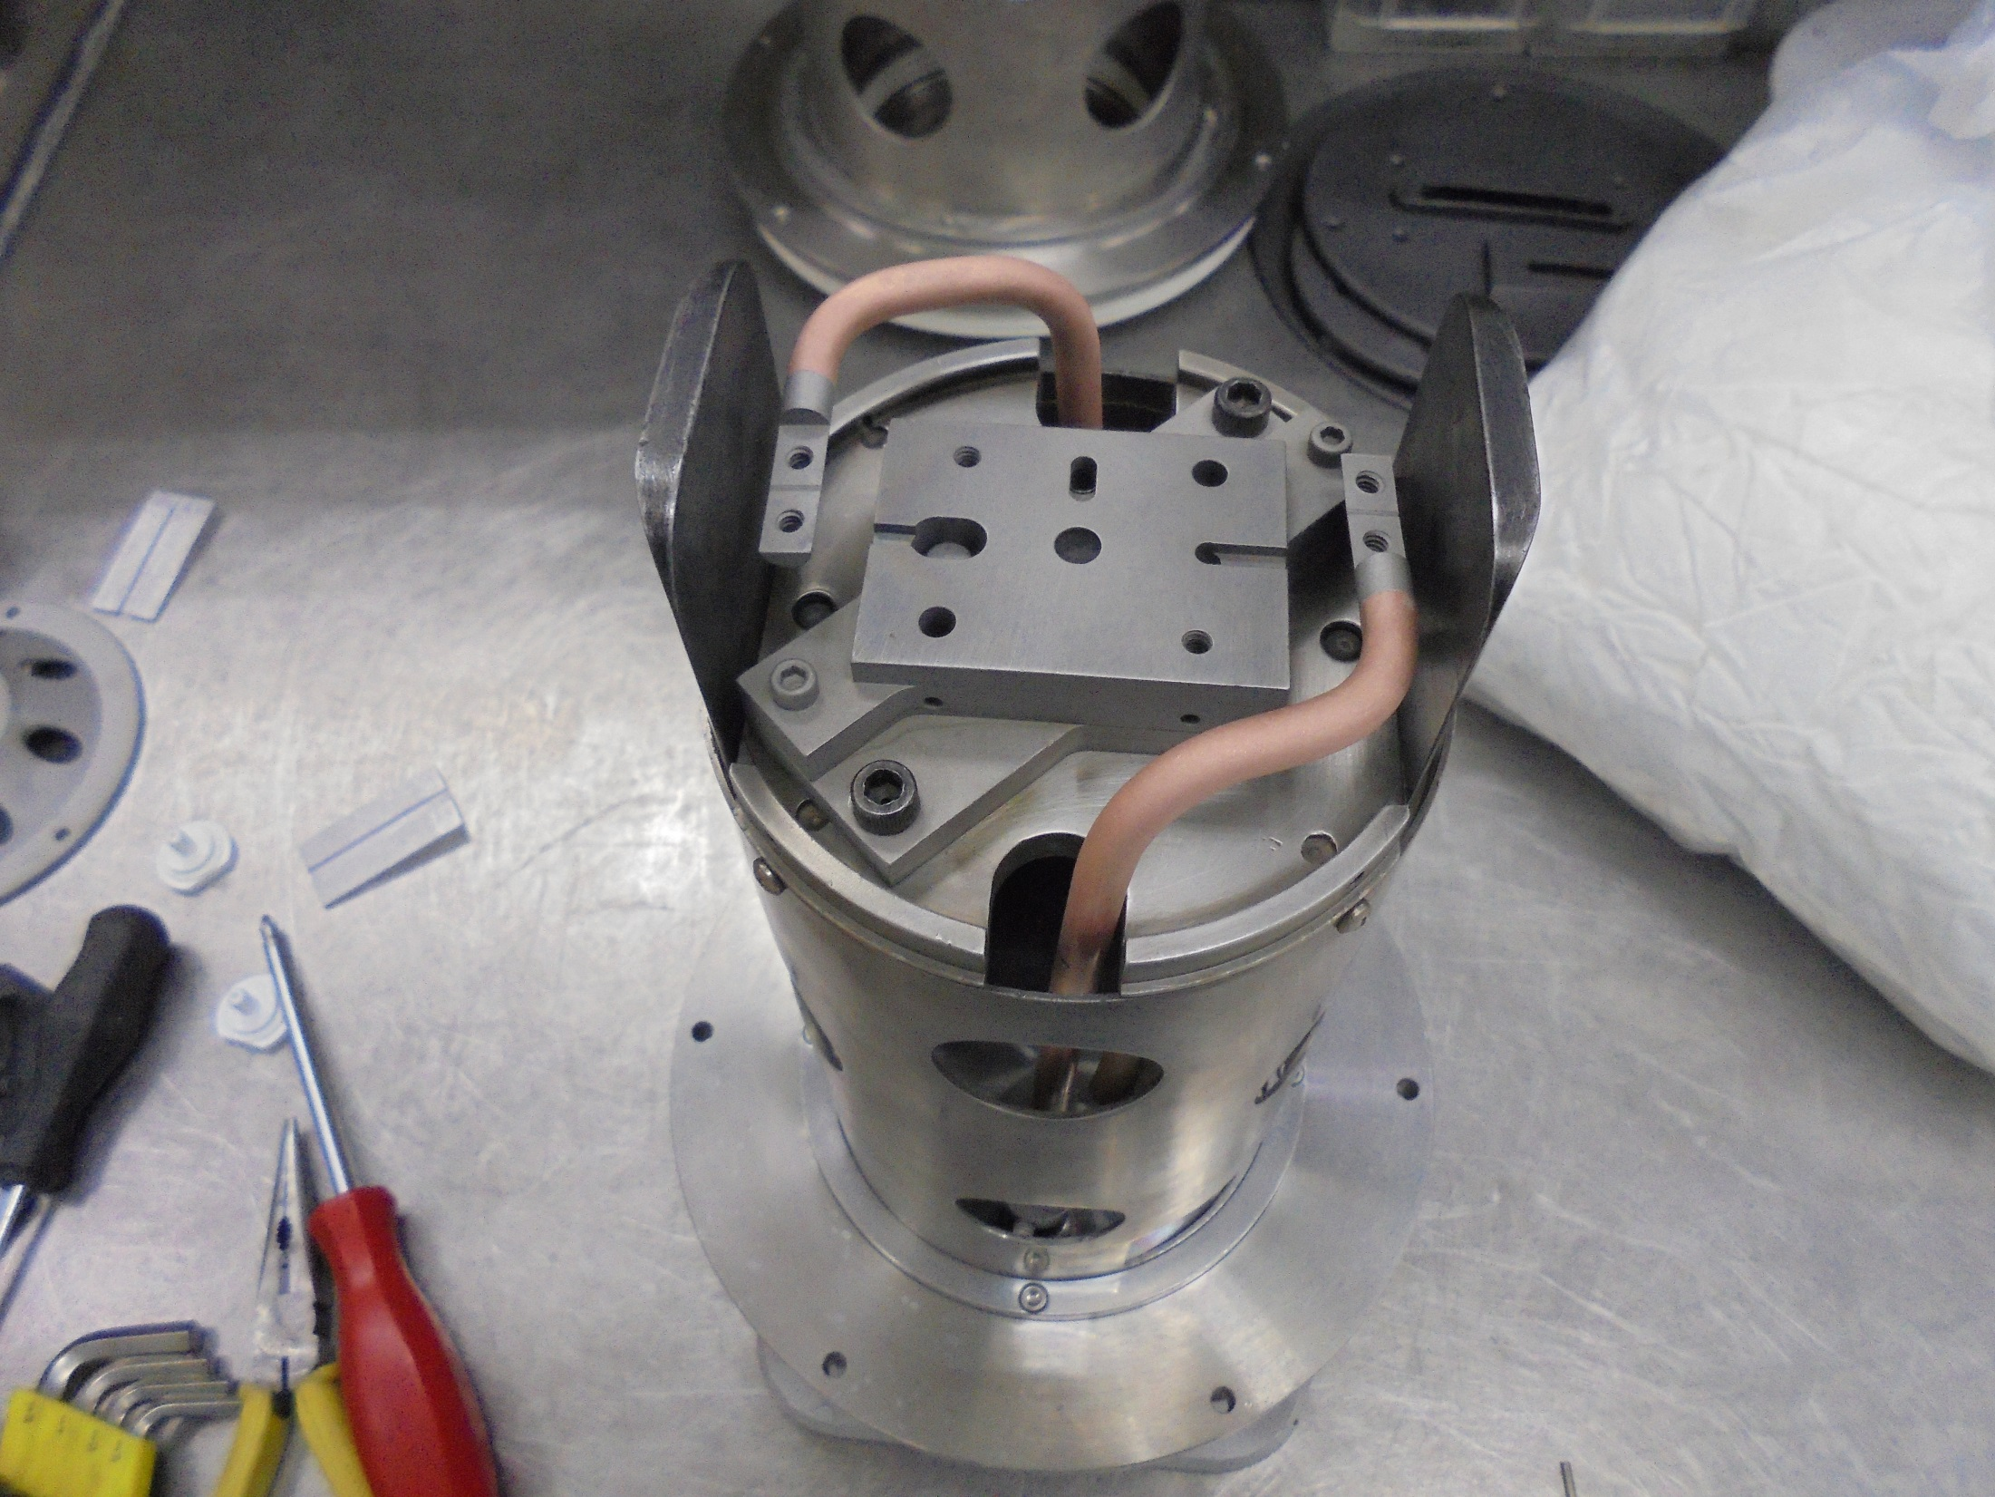

Slide 15
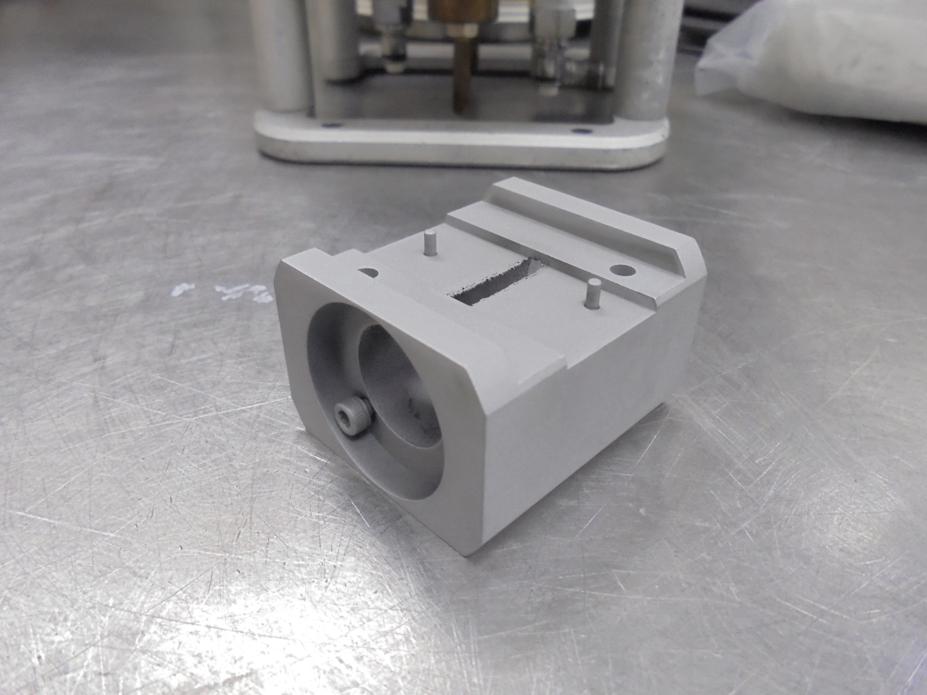
ARC CHAMBER

Slide 16
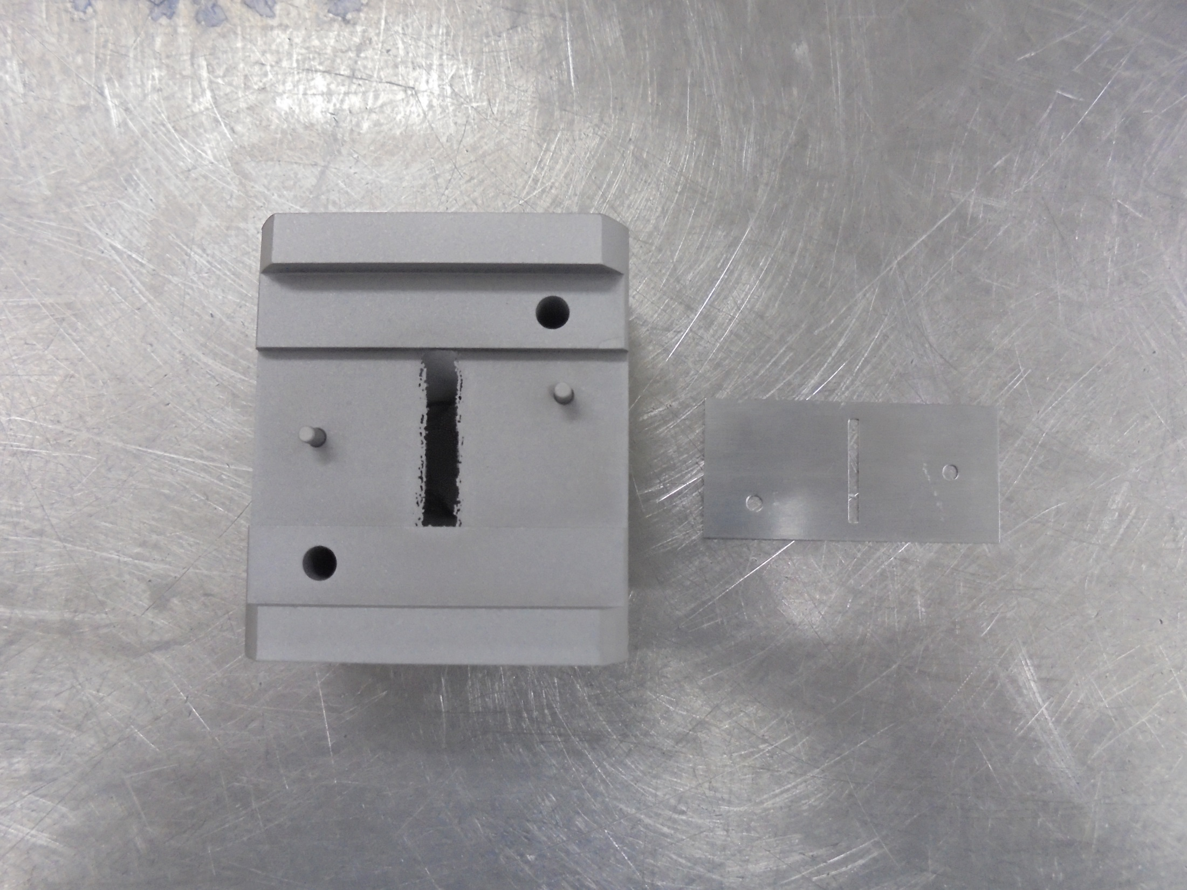
Install here
EMISSIVE INSERT

Slide 17
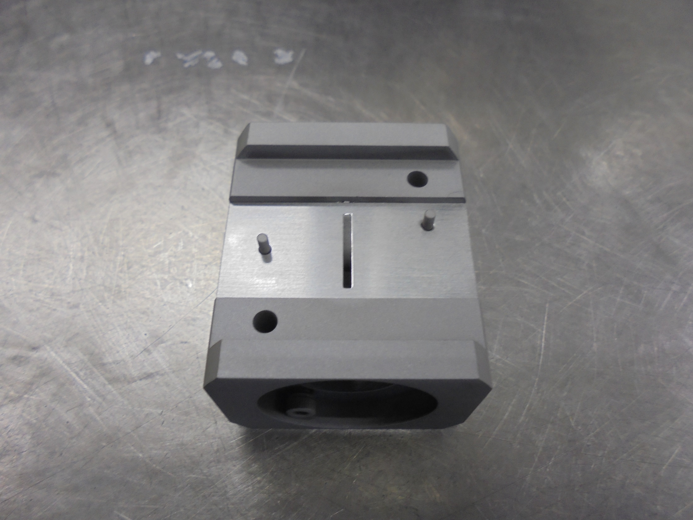
EMMISIVE INSERT Already Install

Slide 18
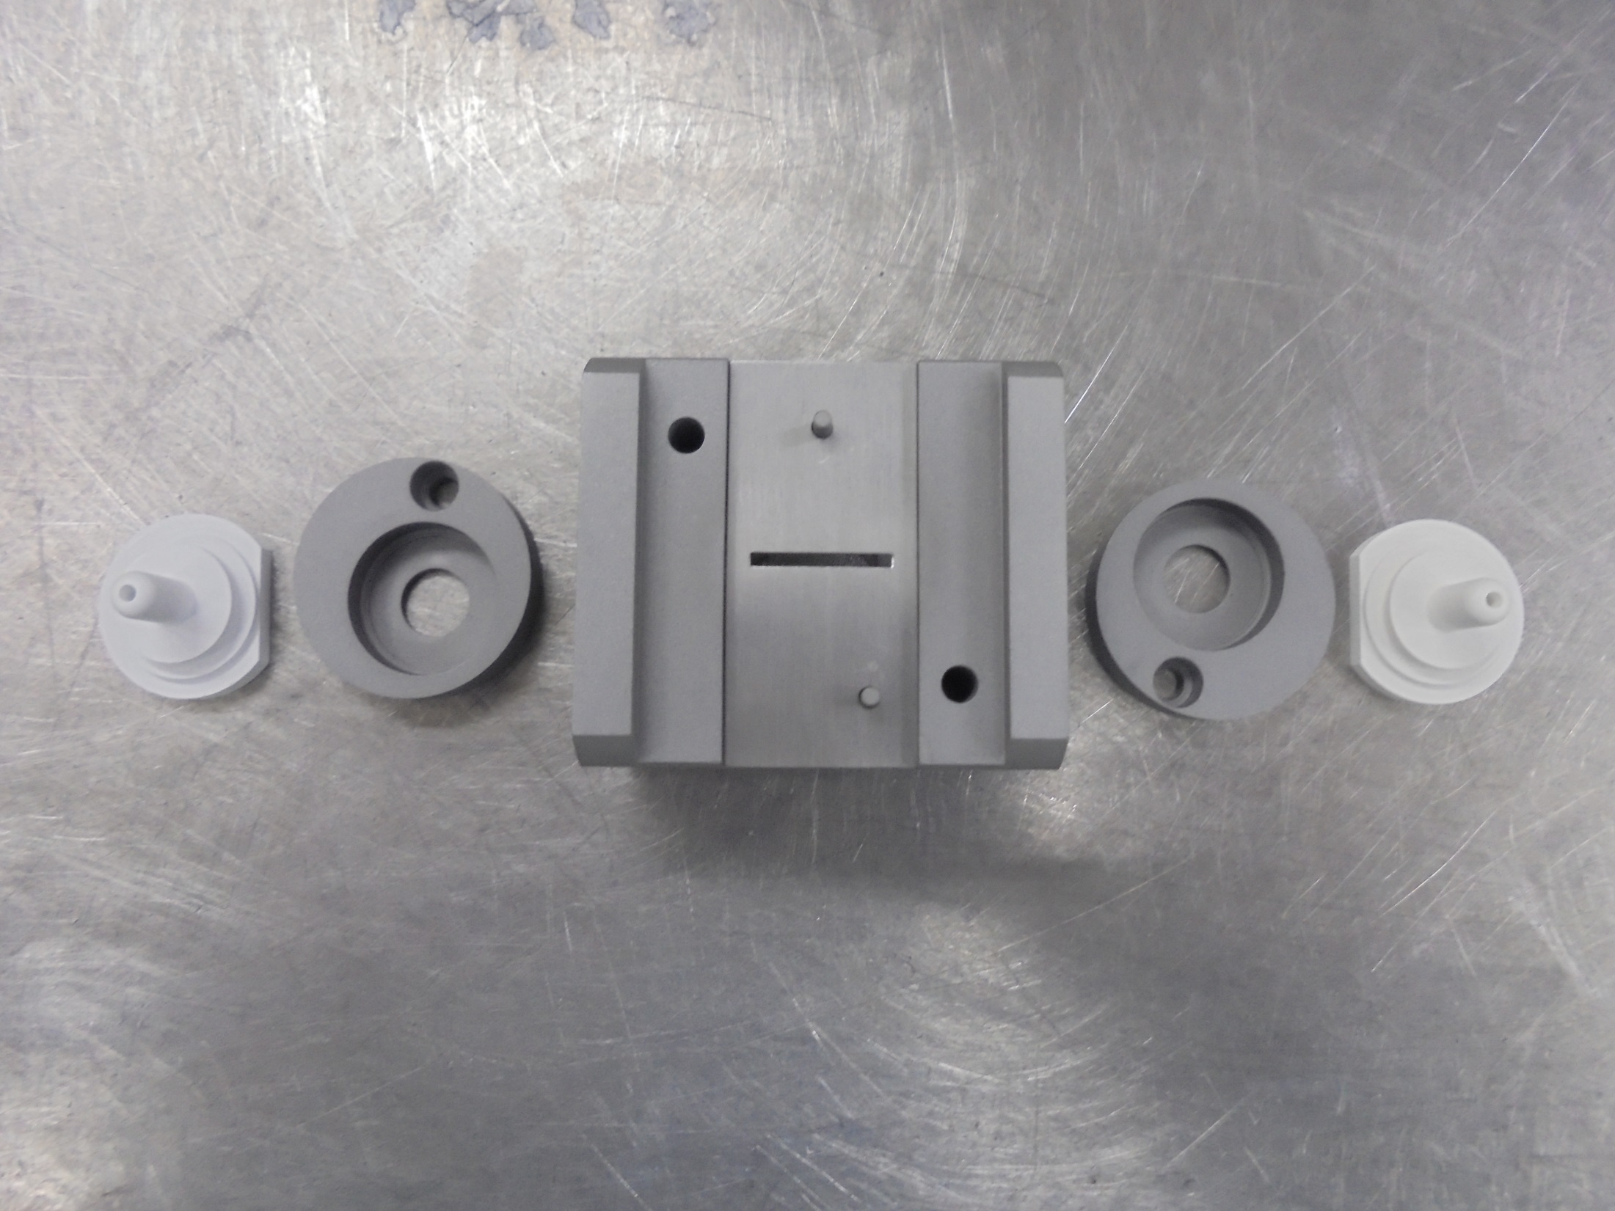
ARC CHAMBER END CAP
FILAMENT INSULATOR

Slide 19
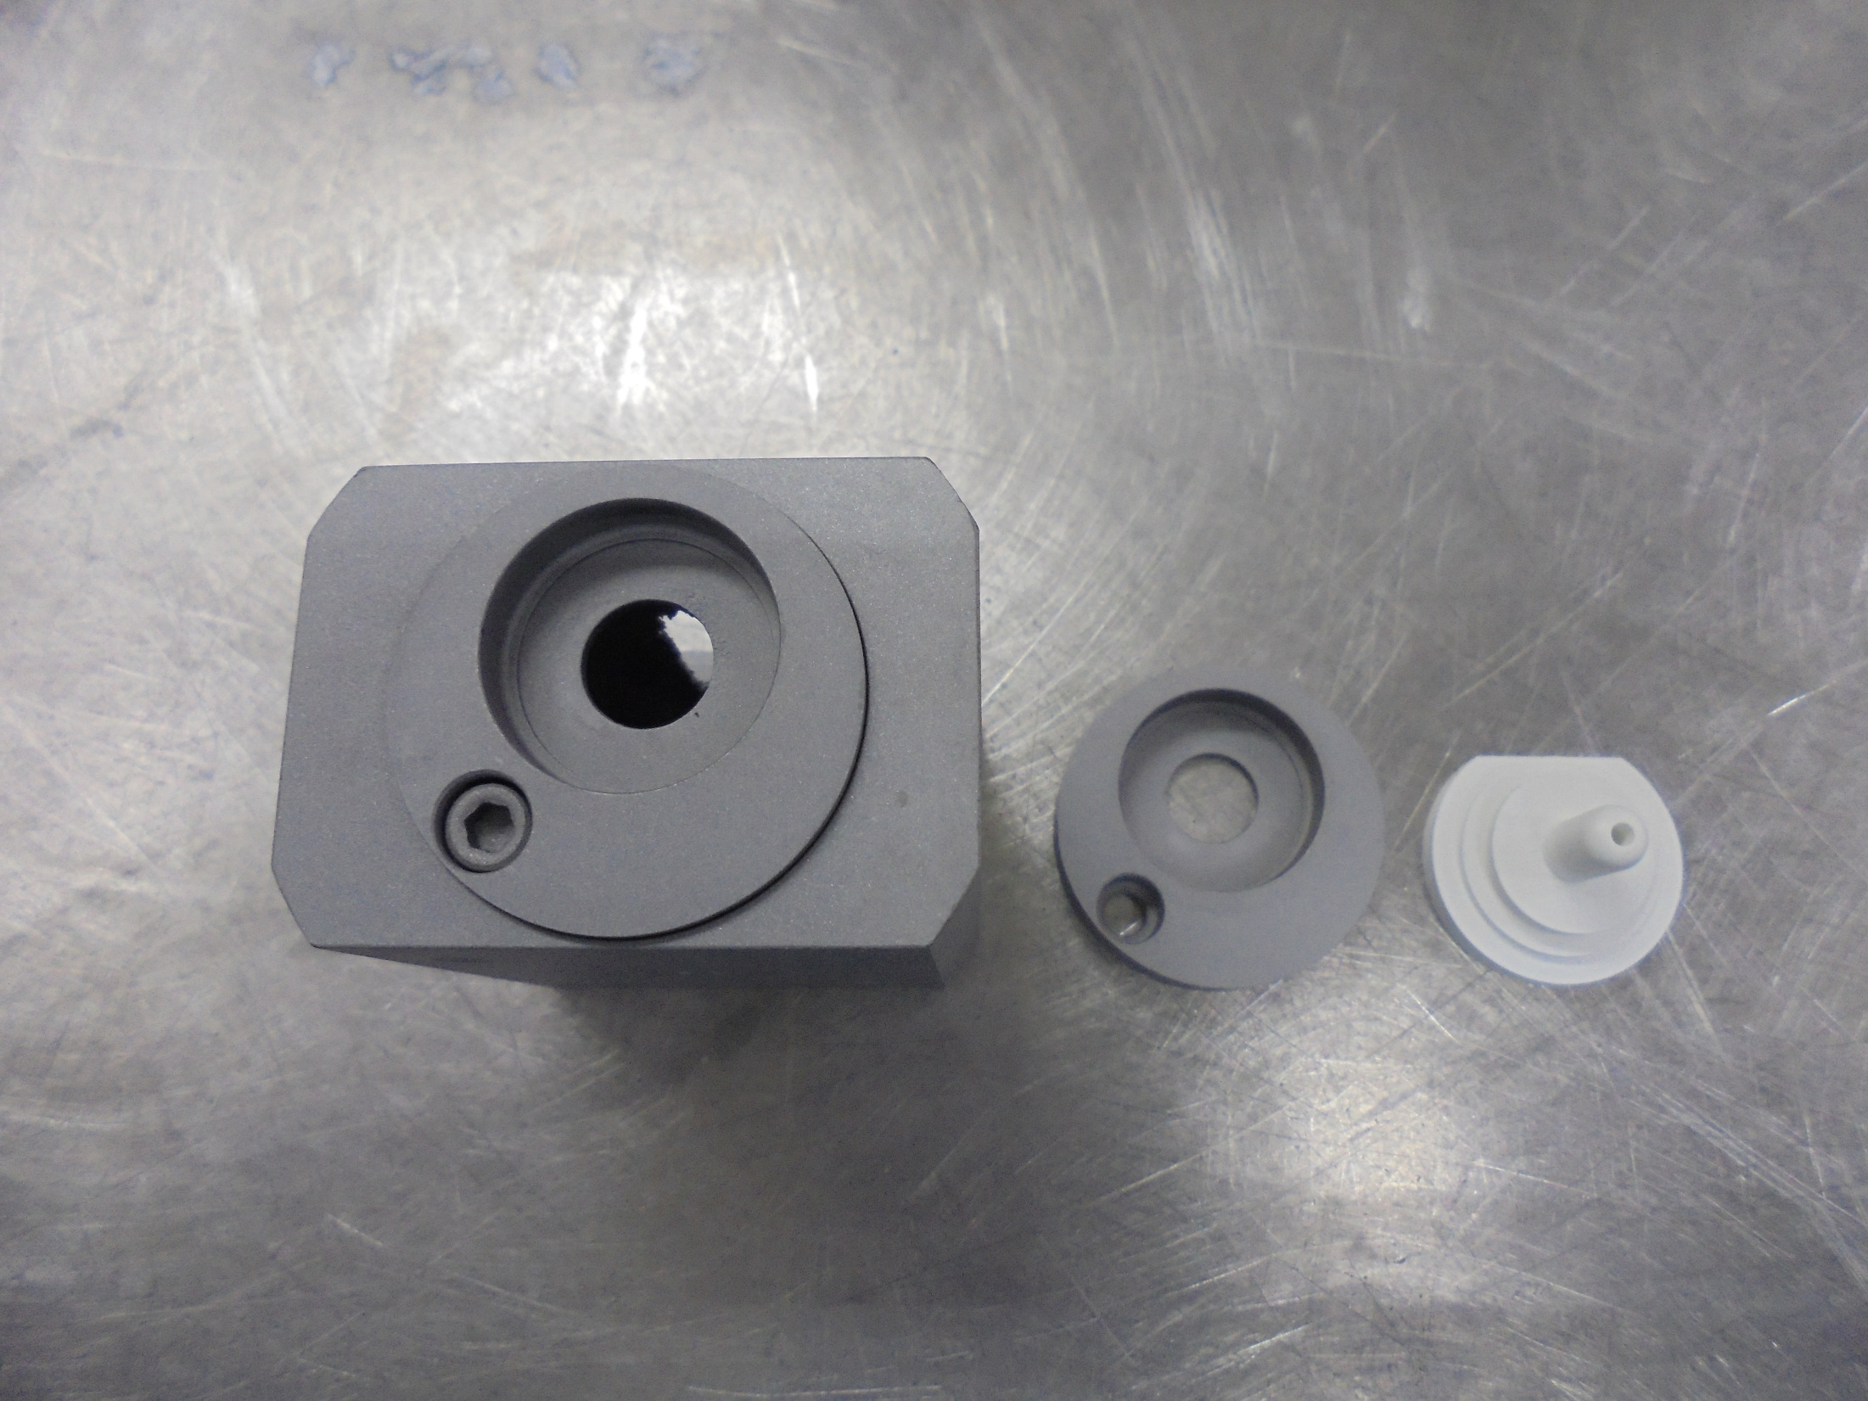
*Notice: Do Not Tighten the Screw to Much

Slide 20
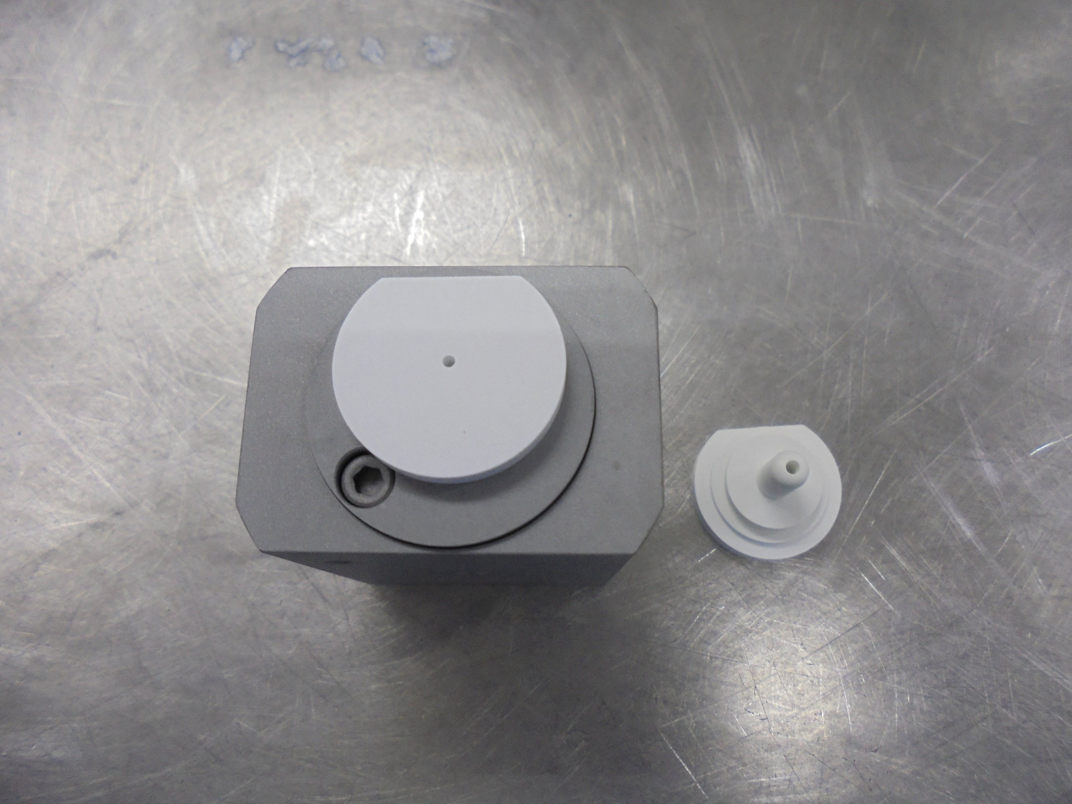

Slide 21
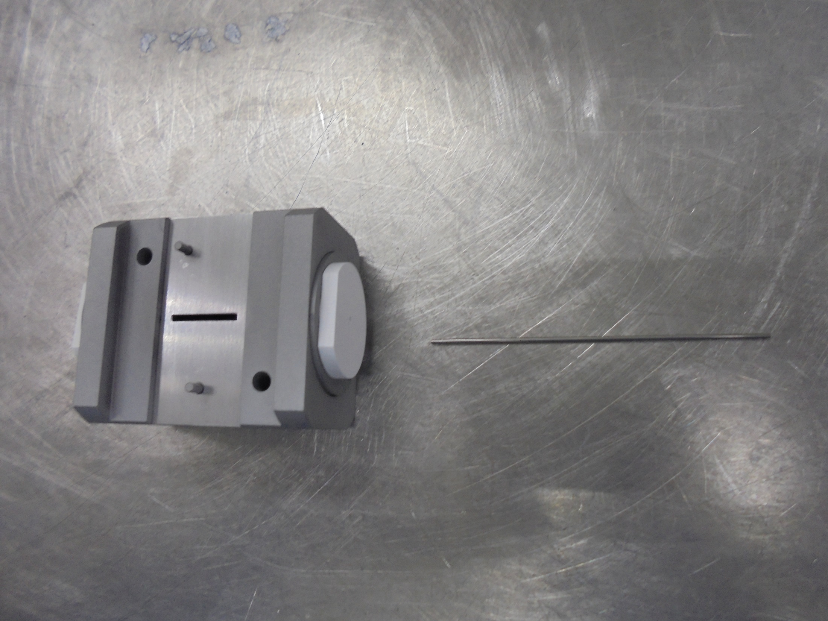
insert in the hole
FILAMENT

Slide 22
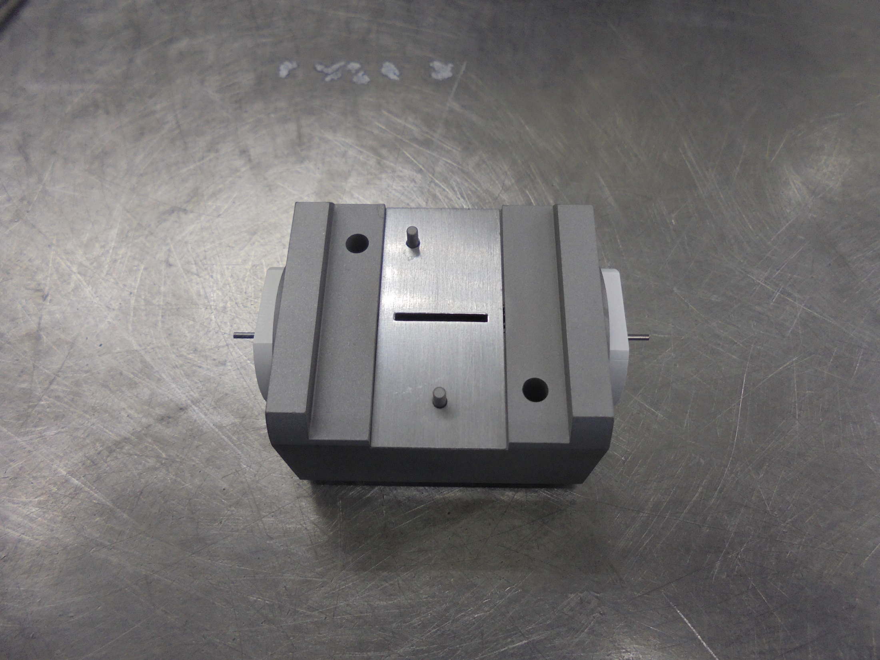
*notice: the FILAMENT on both side (encircle)

Slide 23
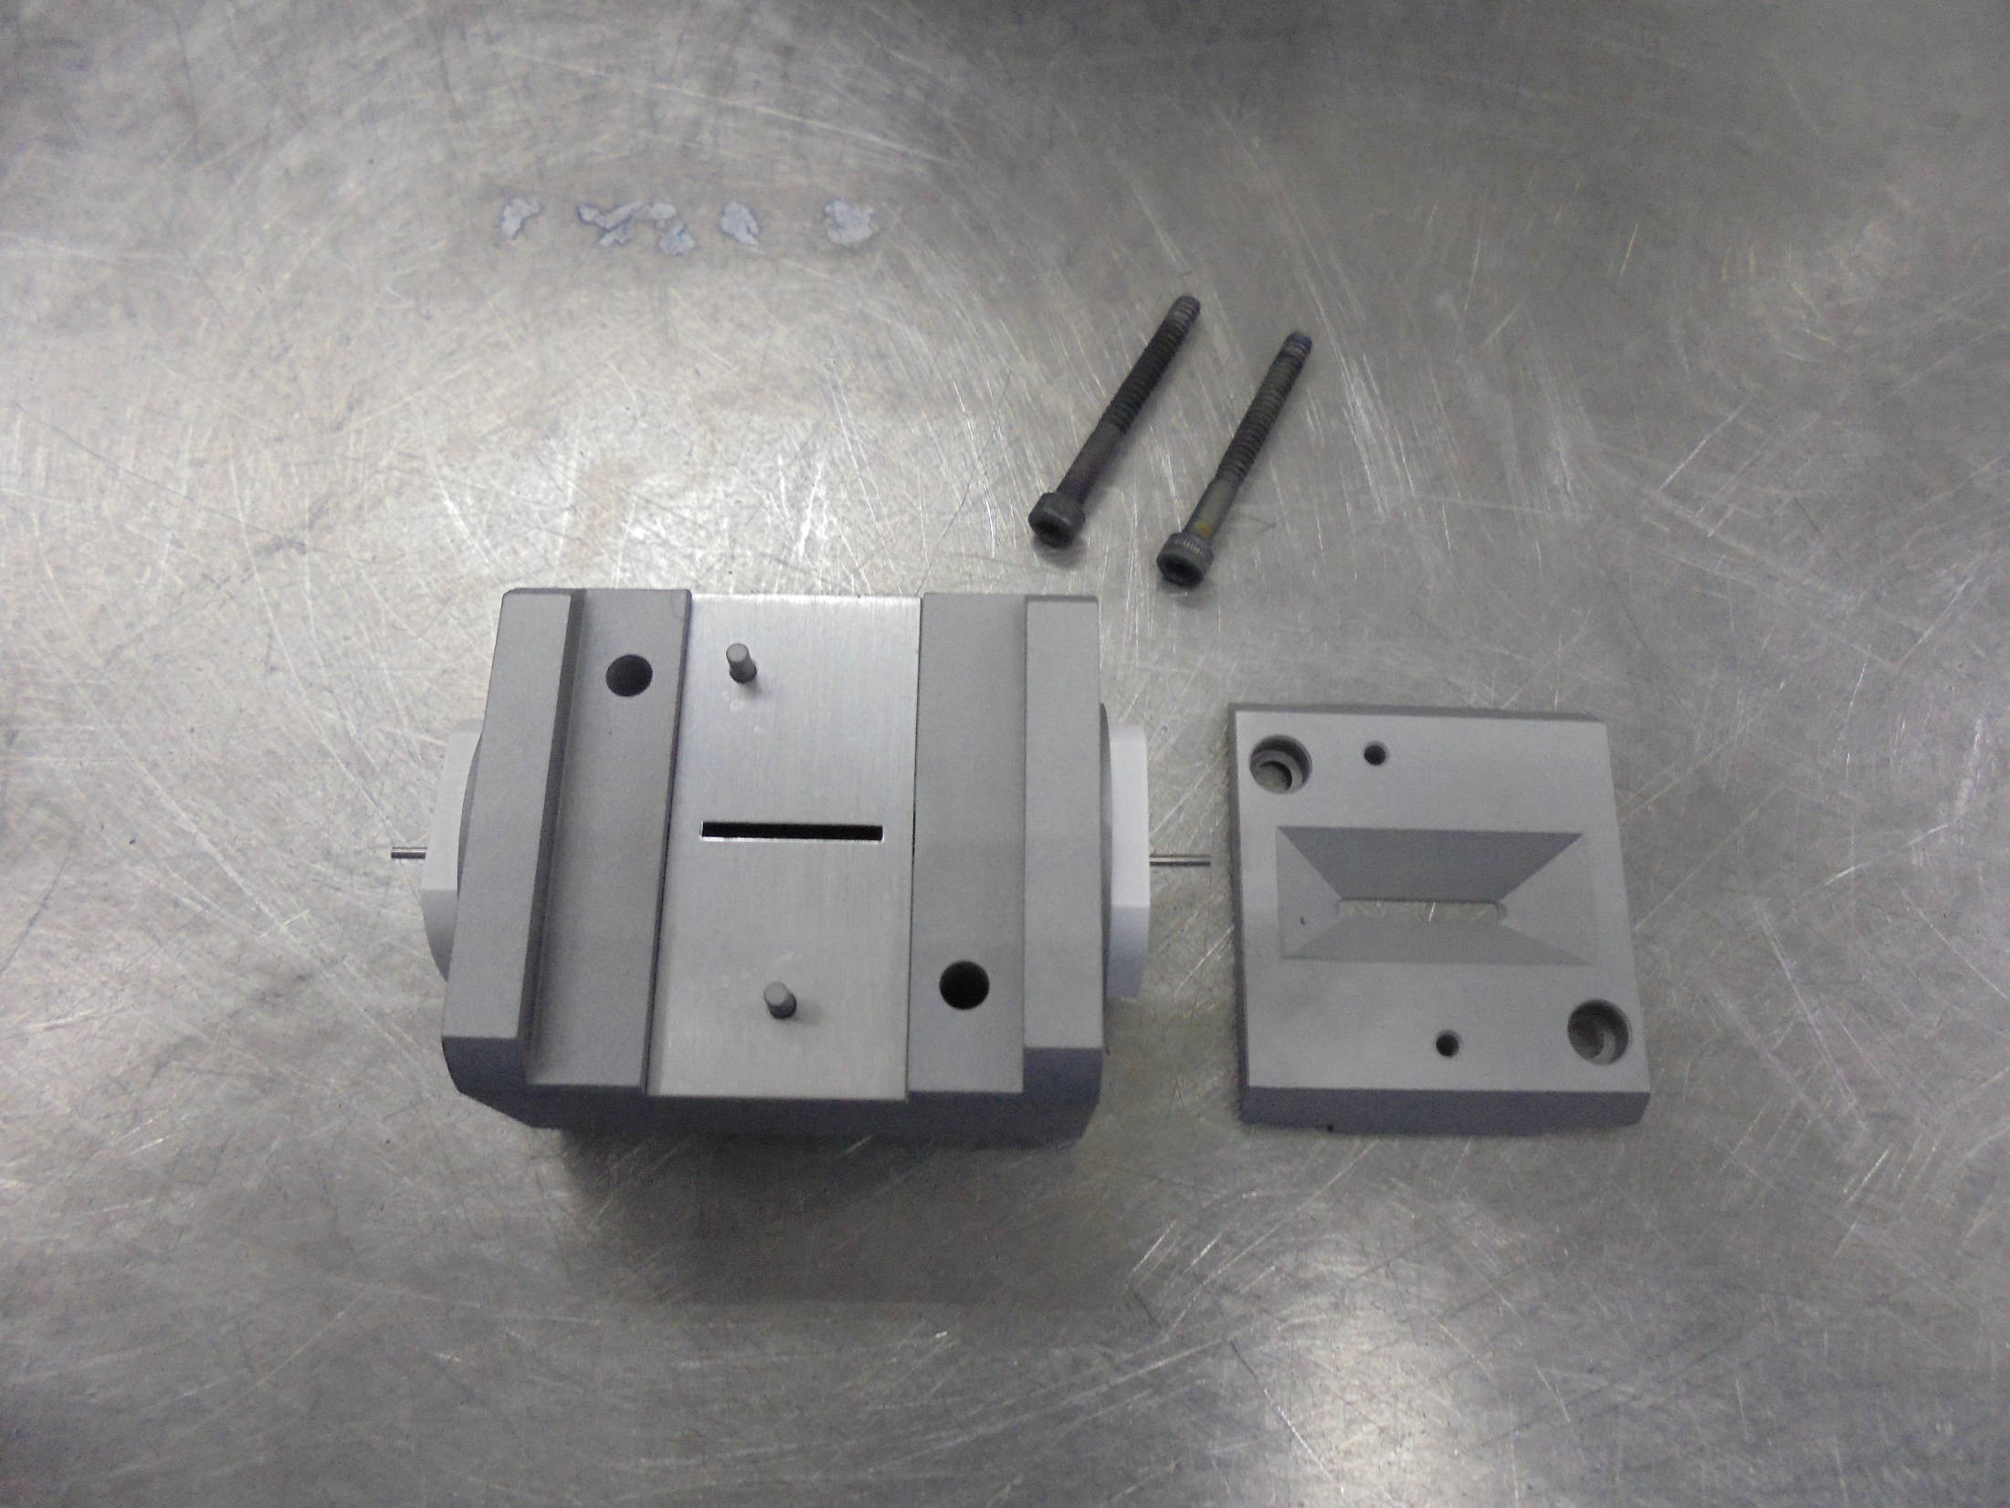
ELCTD EMMISIVE ARC CHAMBER

Slide 24
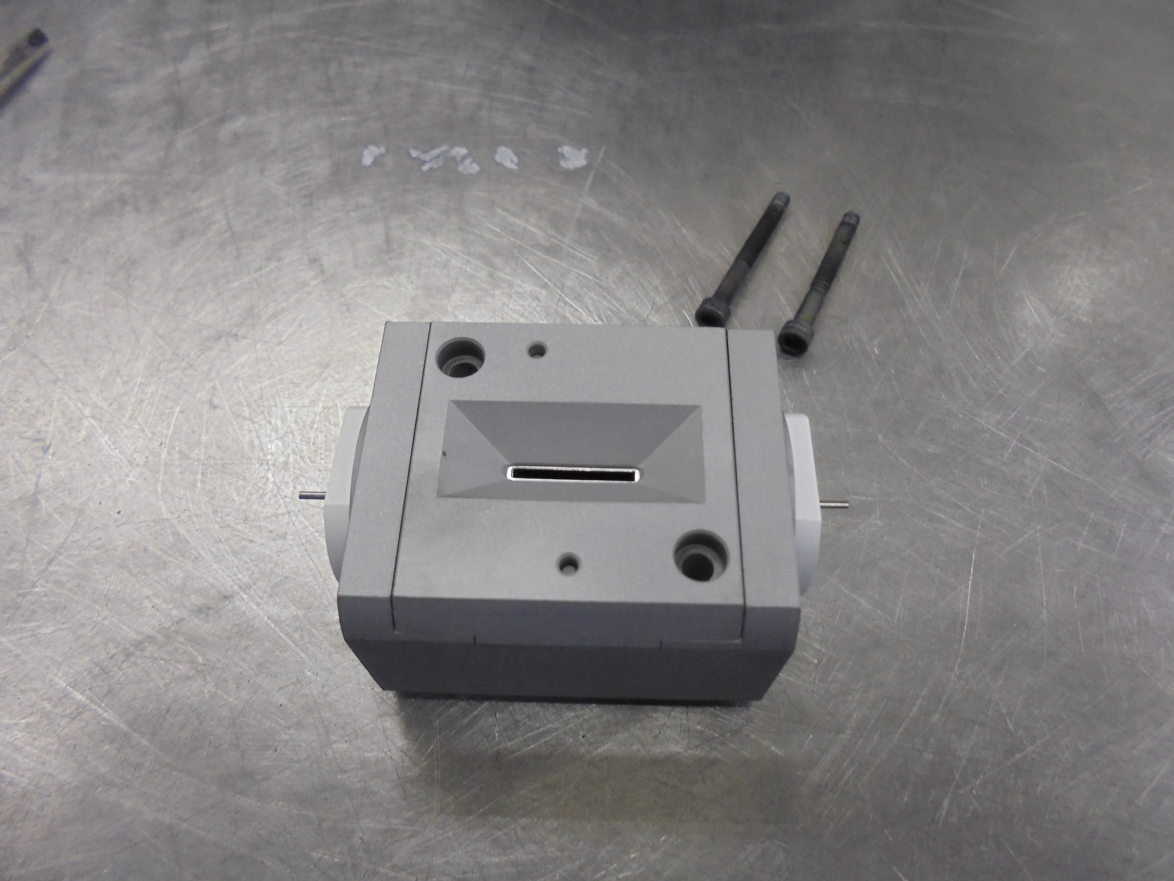
TOP of
ARC CHAMBER

Slide 25
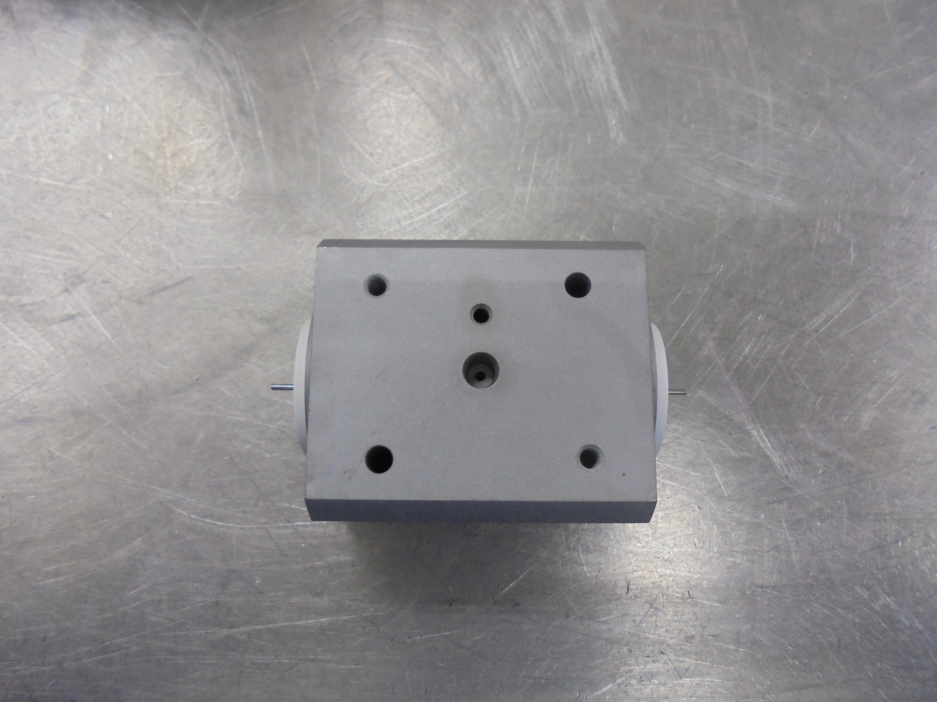
BOTTOM of
ARC CHAMBER
GAS LINE

Slide 26
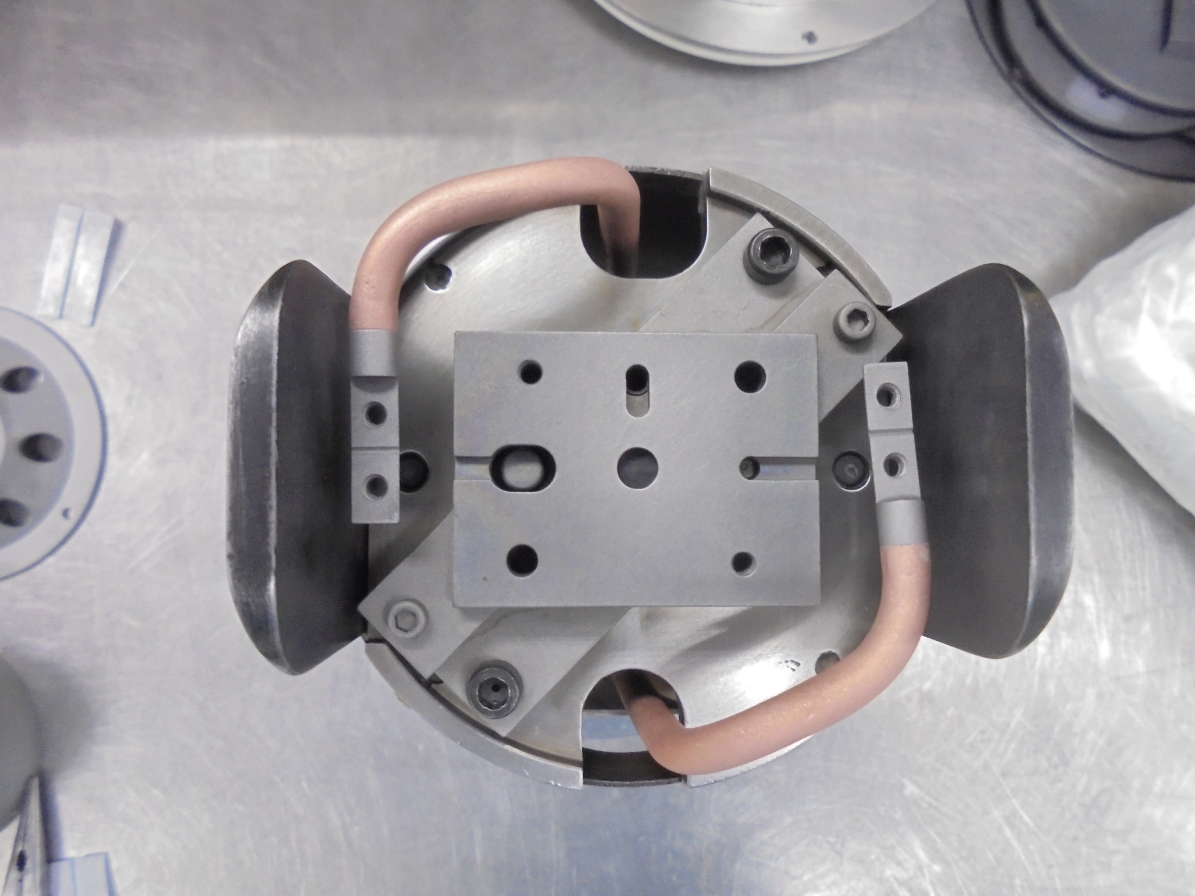
Gas Line

Slide 27
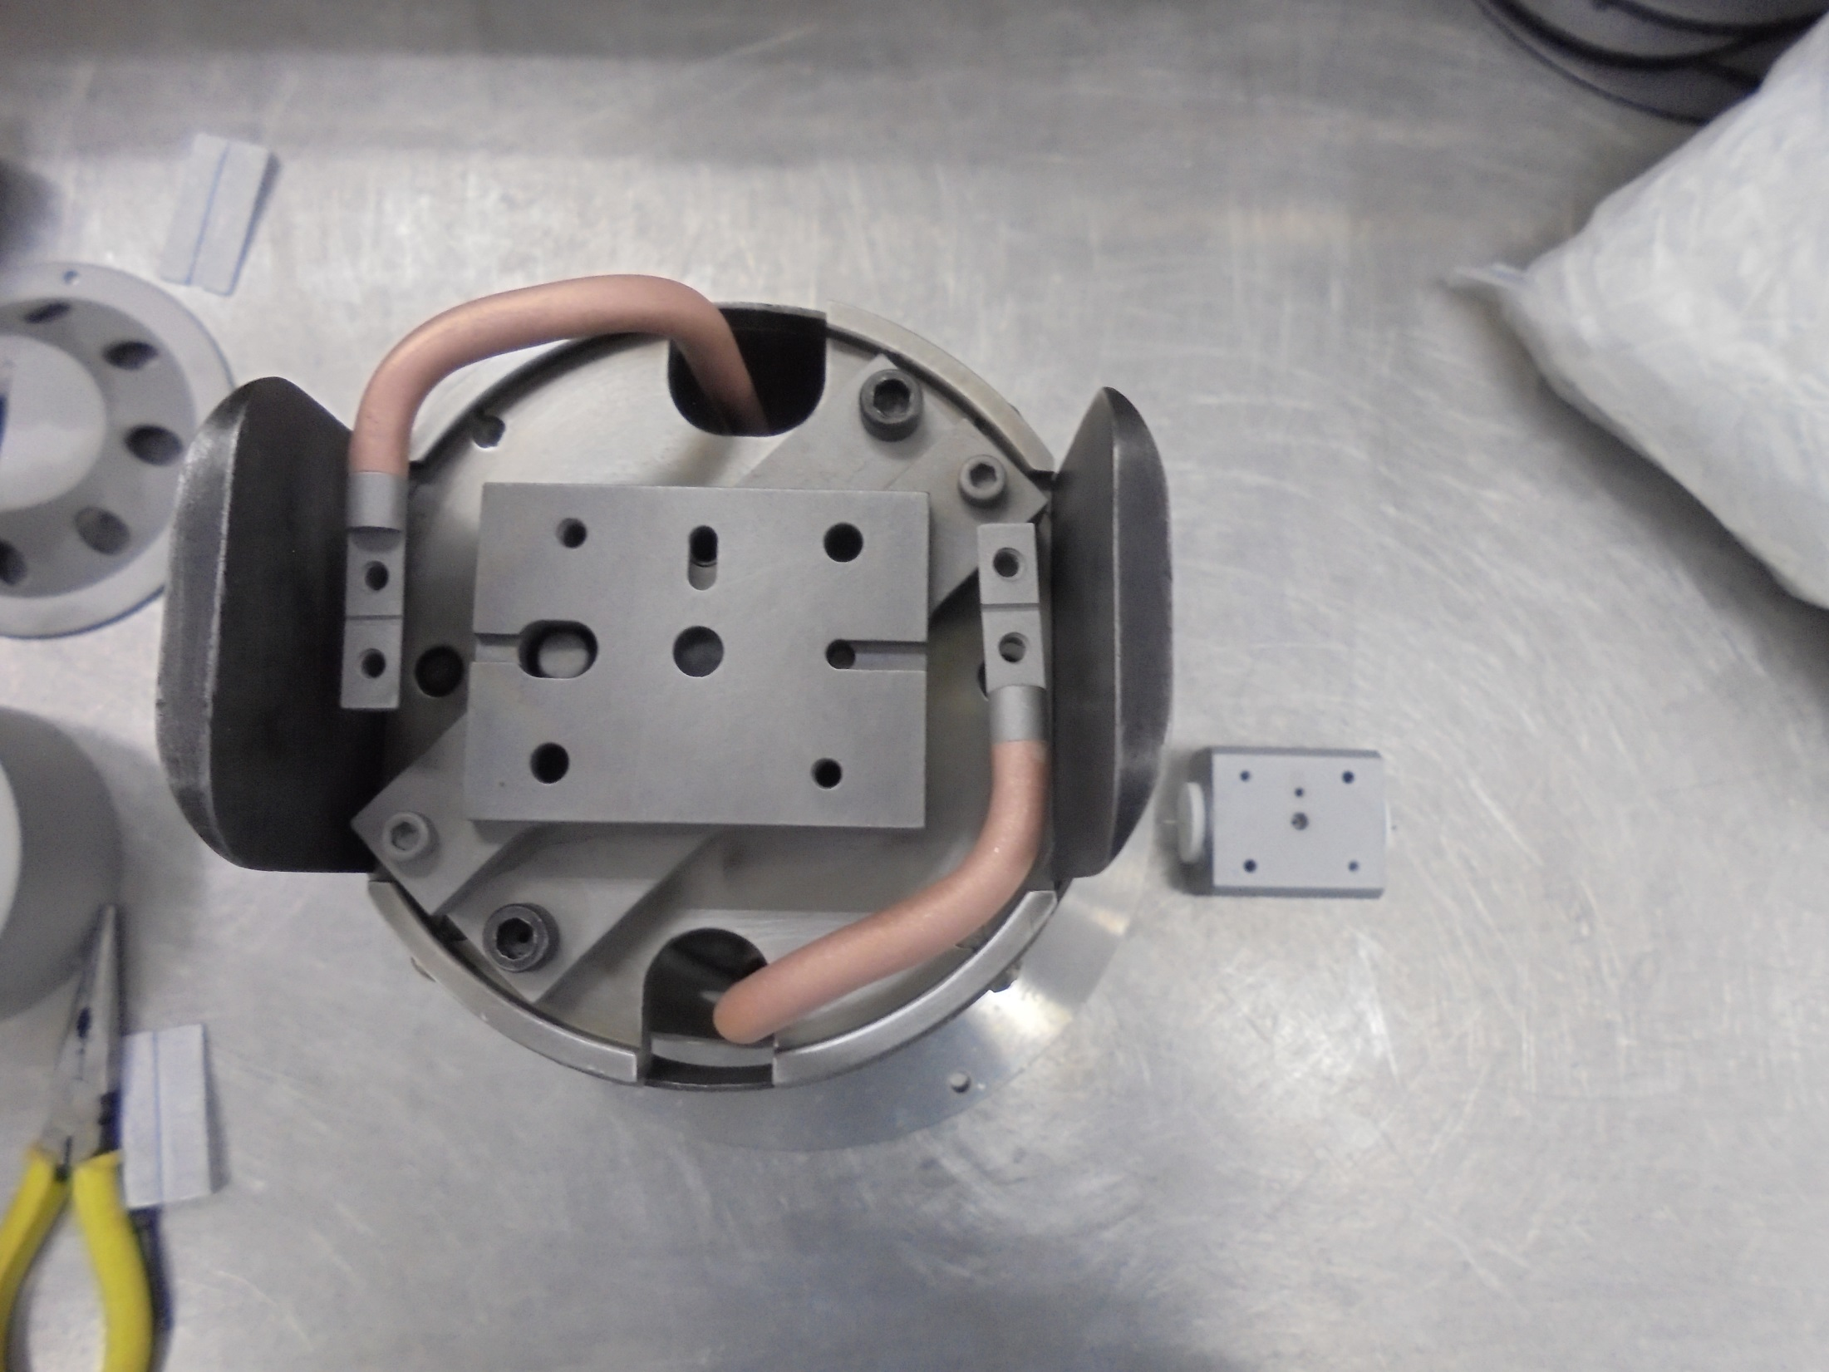
*Notice: the correct orientation of GAS LINE

Slide 28
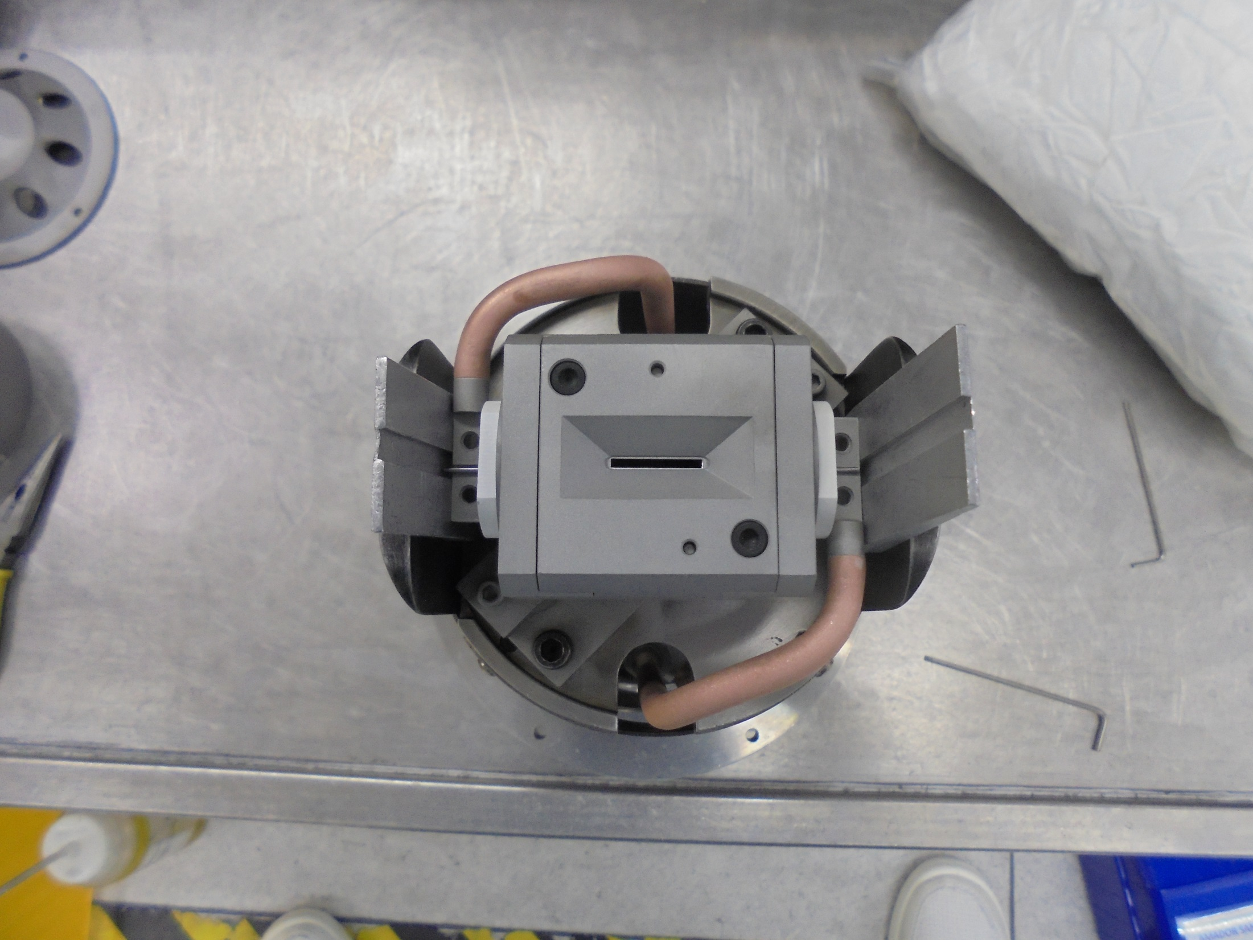
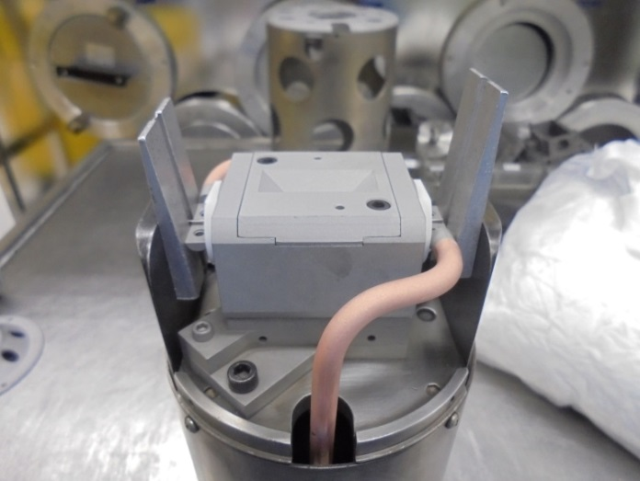
ALIGNMENT JIG Inserted

Slide 29
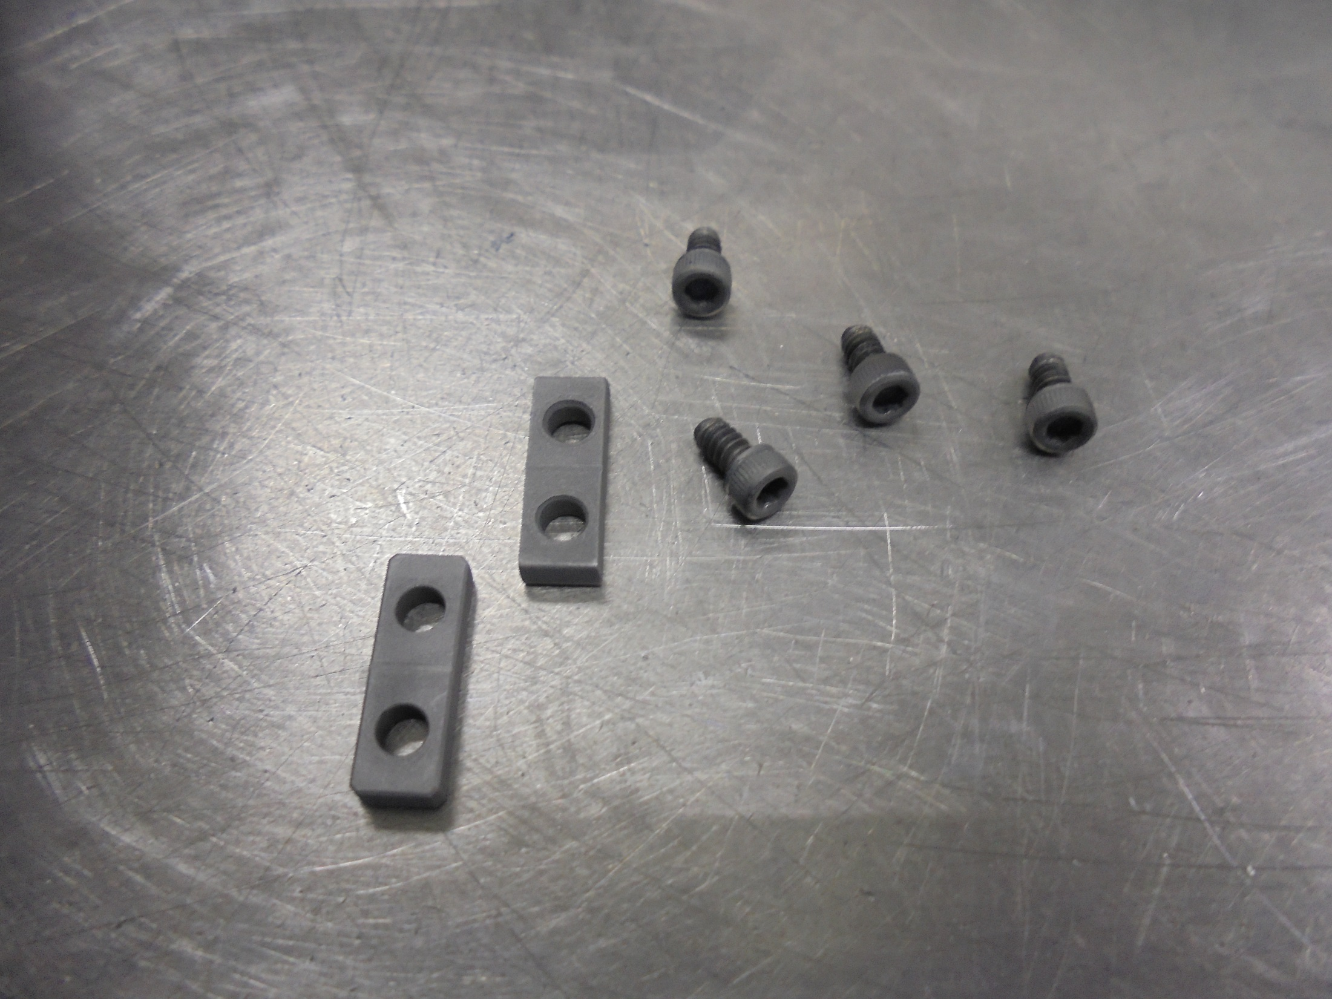
FILAMENT CLAMP
LOCK SCREWS

Slide 30
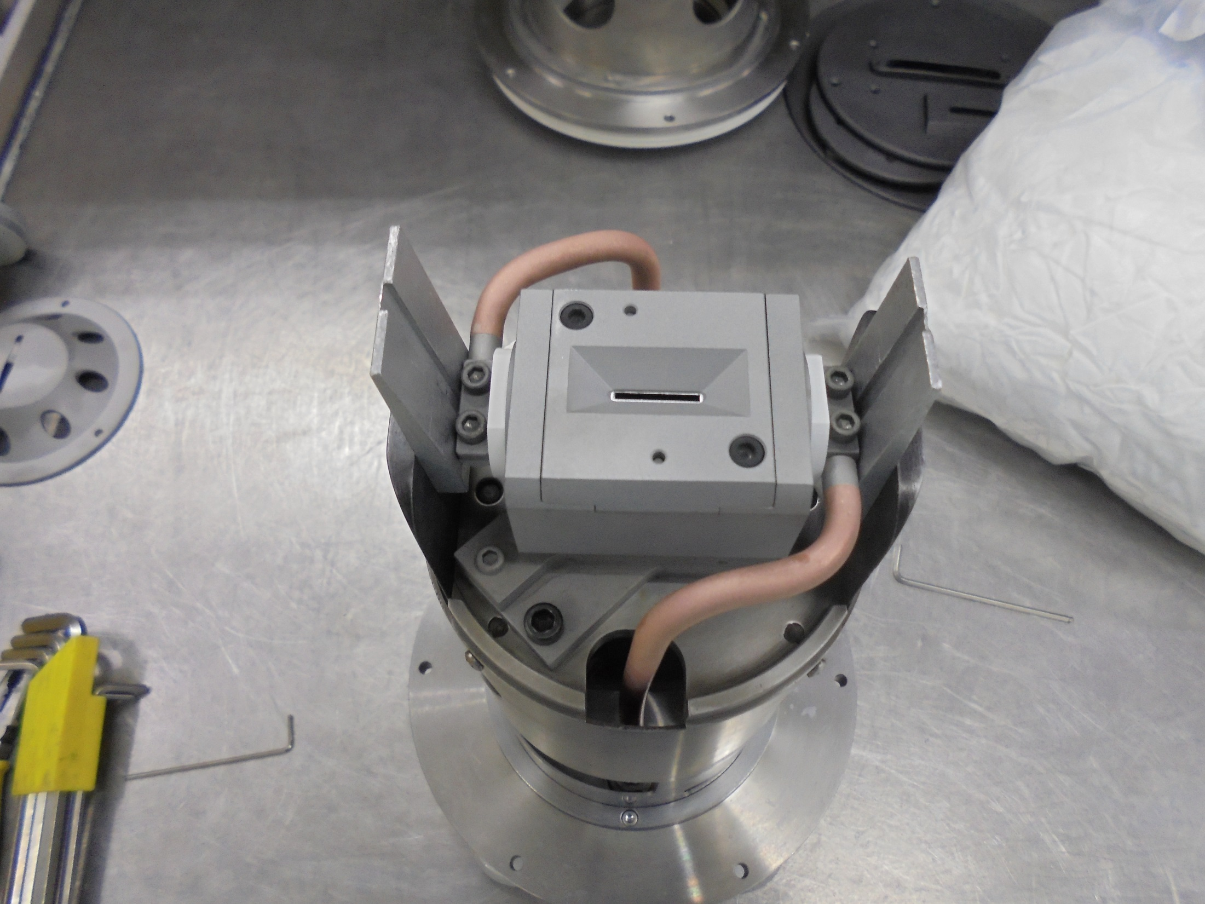
Secure Tighten the CLAMP with Screws

Slide 31
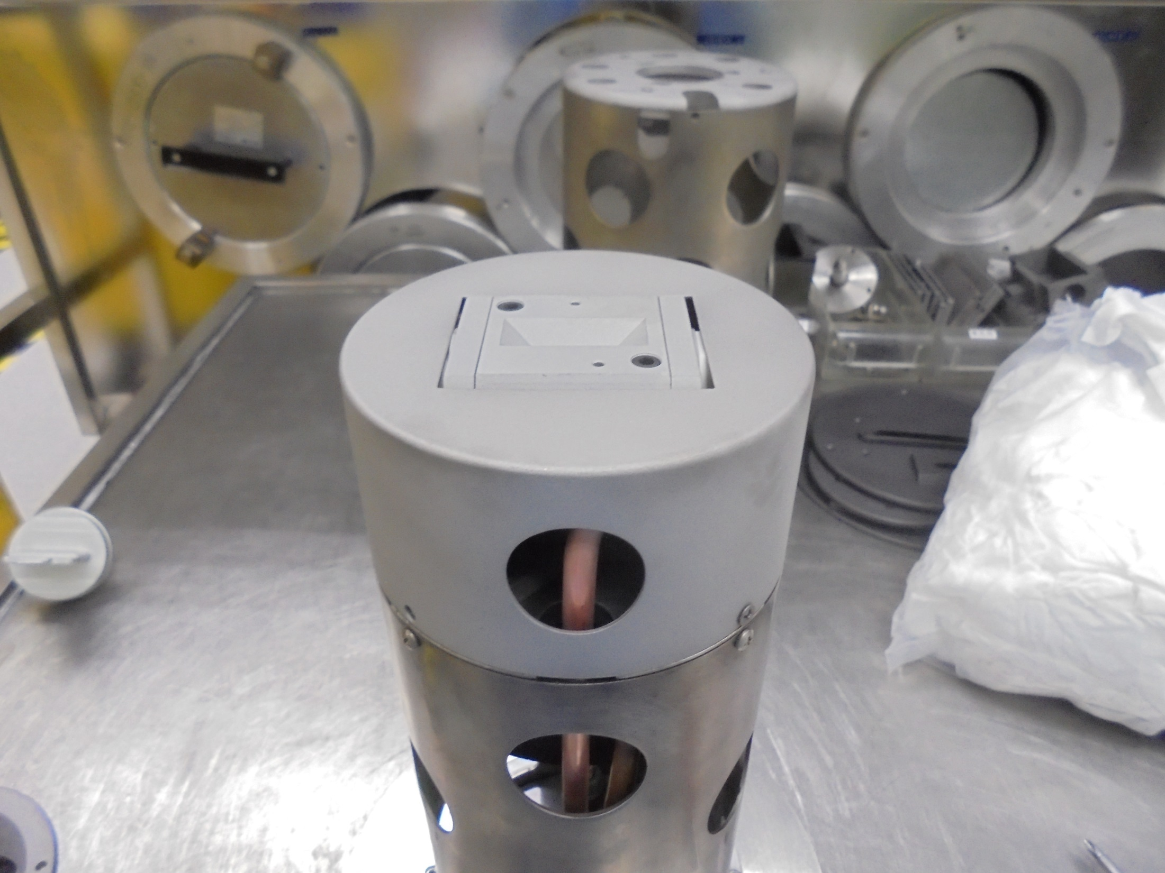
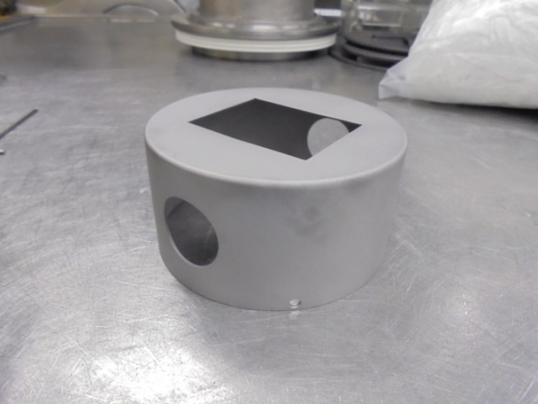
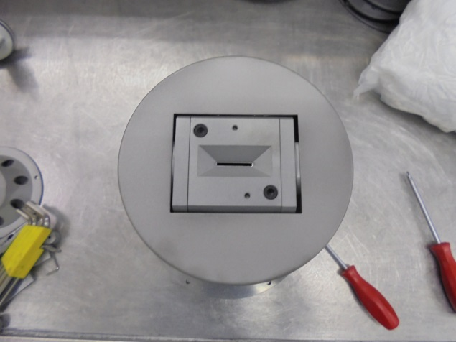
Install Cover

Slide 32
Source Housing and Electrode

Slide 33
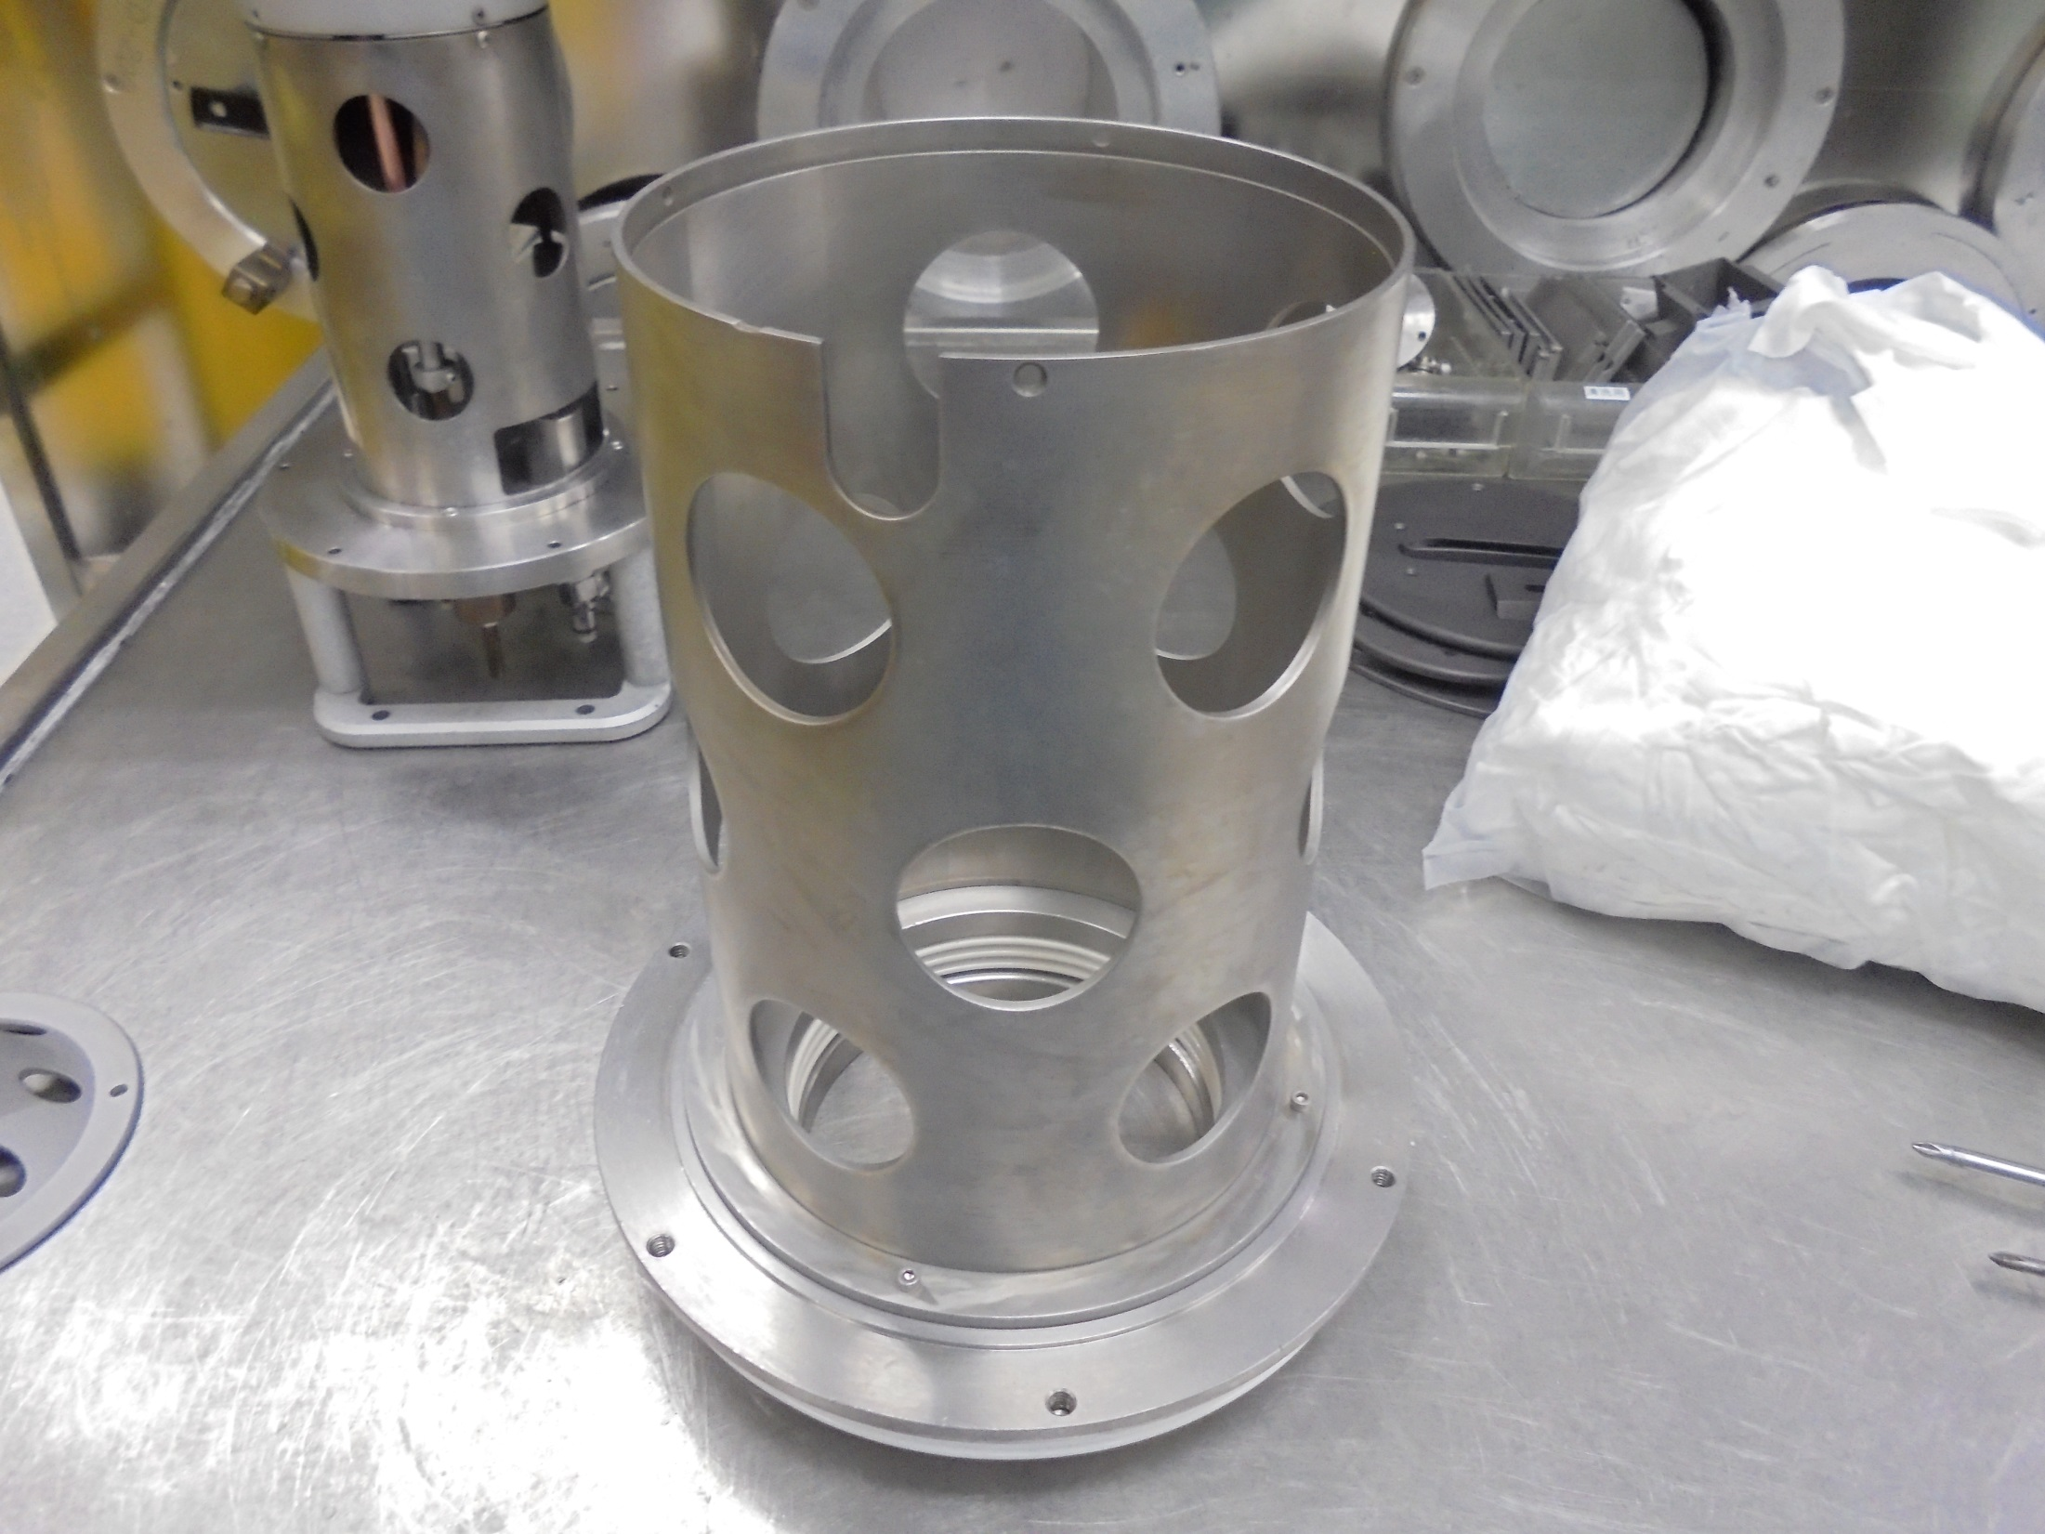
SOURCE HOUSING

Slide 34
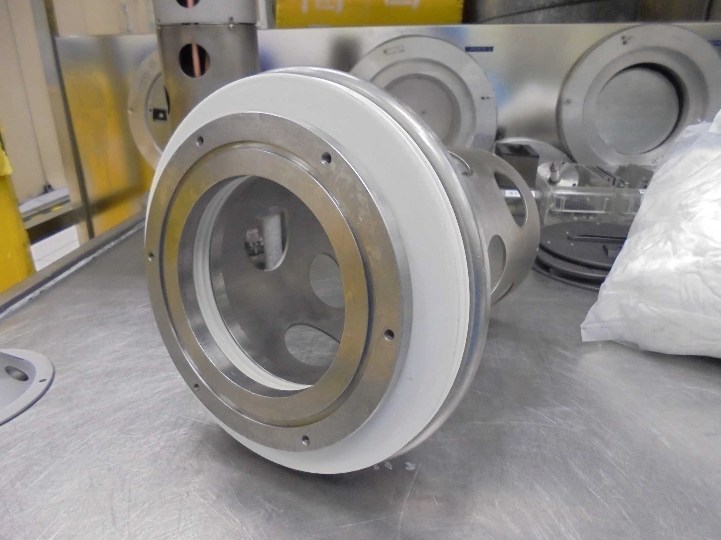
SOURCE BUSHING
O-RING Slot

Slide 35
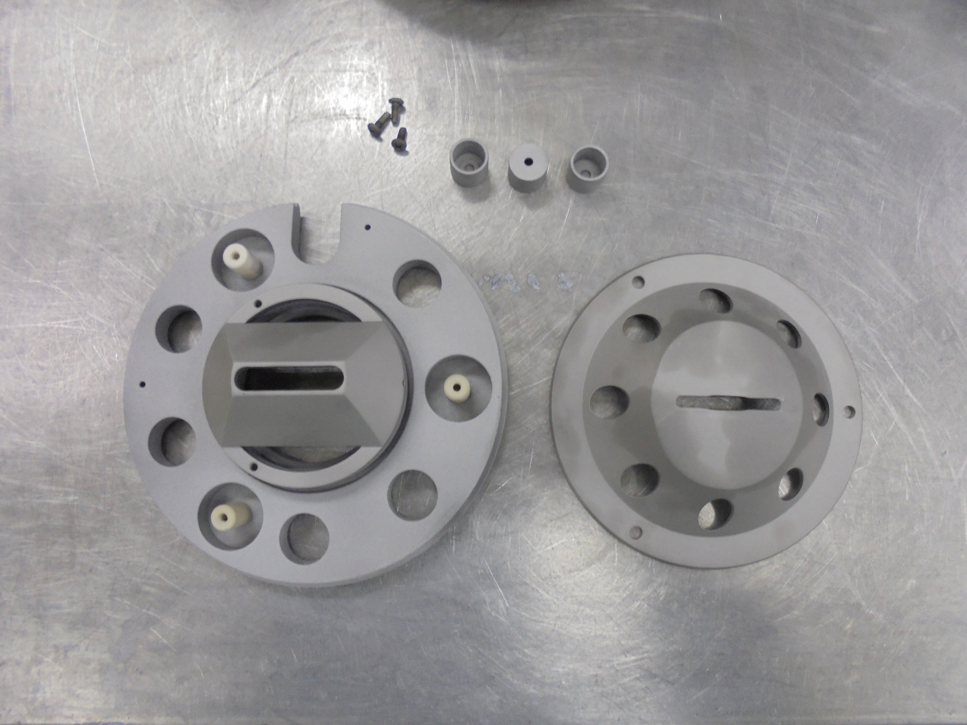
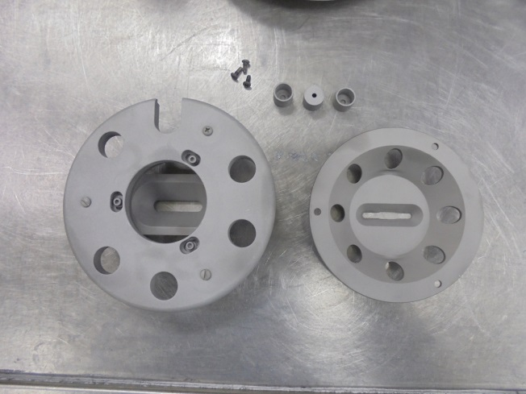
ELECTRODE

Slide 36
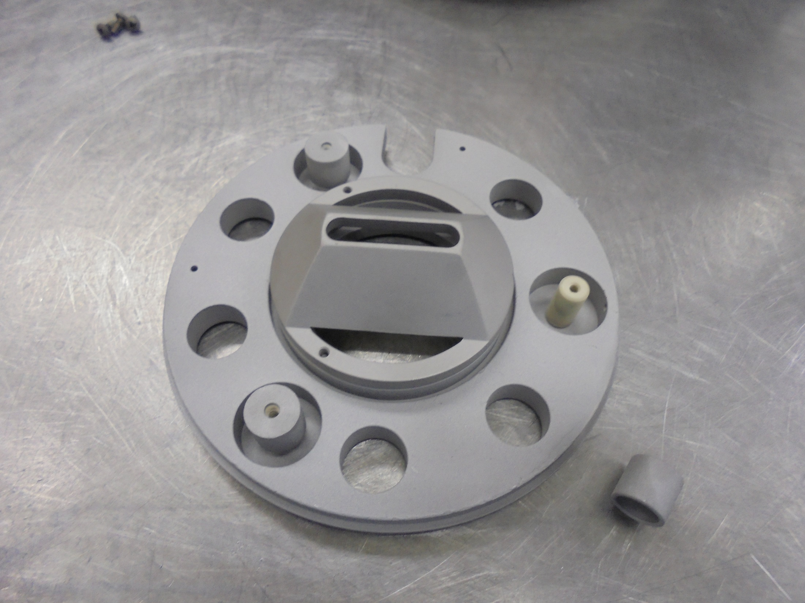
*Install the Cap
Insulator

Slide 37
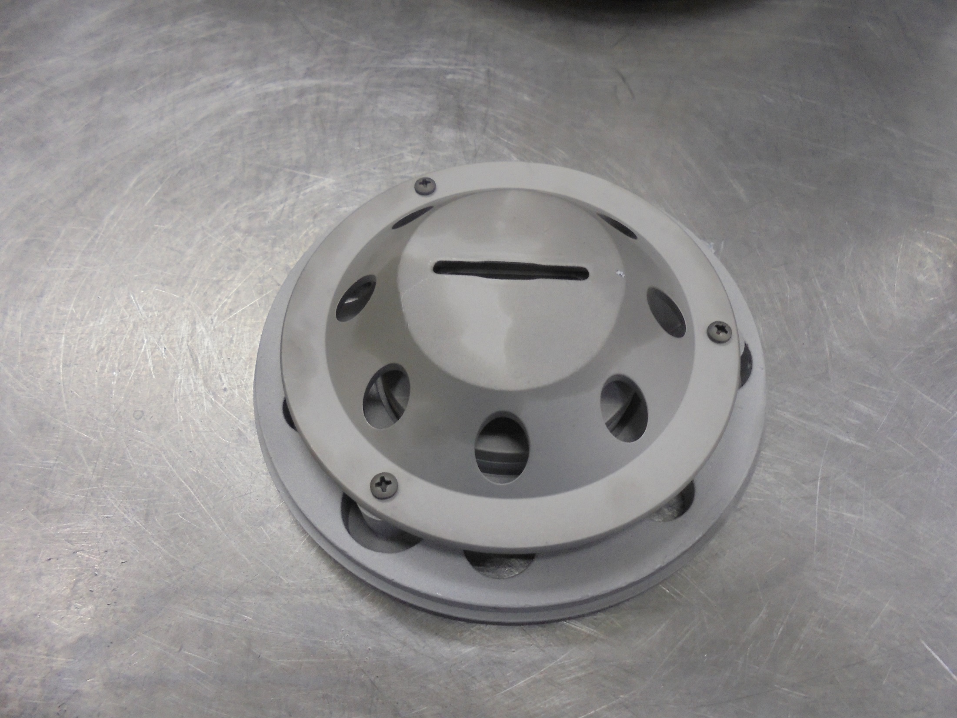
*Attach and secure the screws

Slide 38
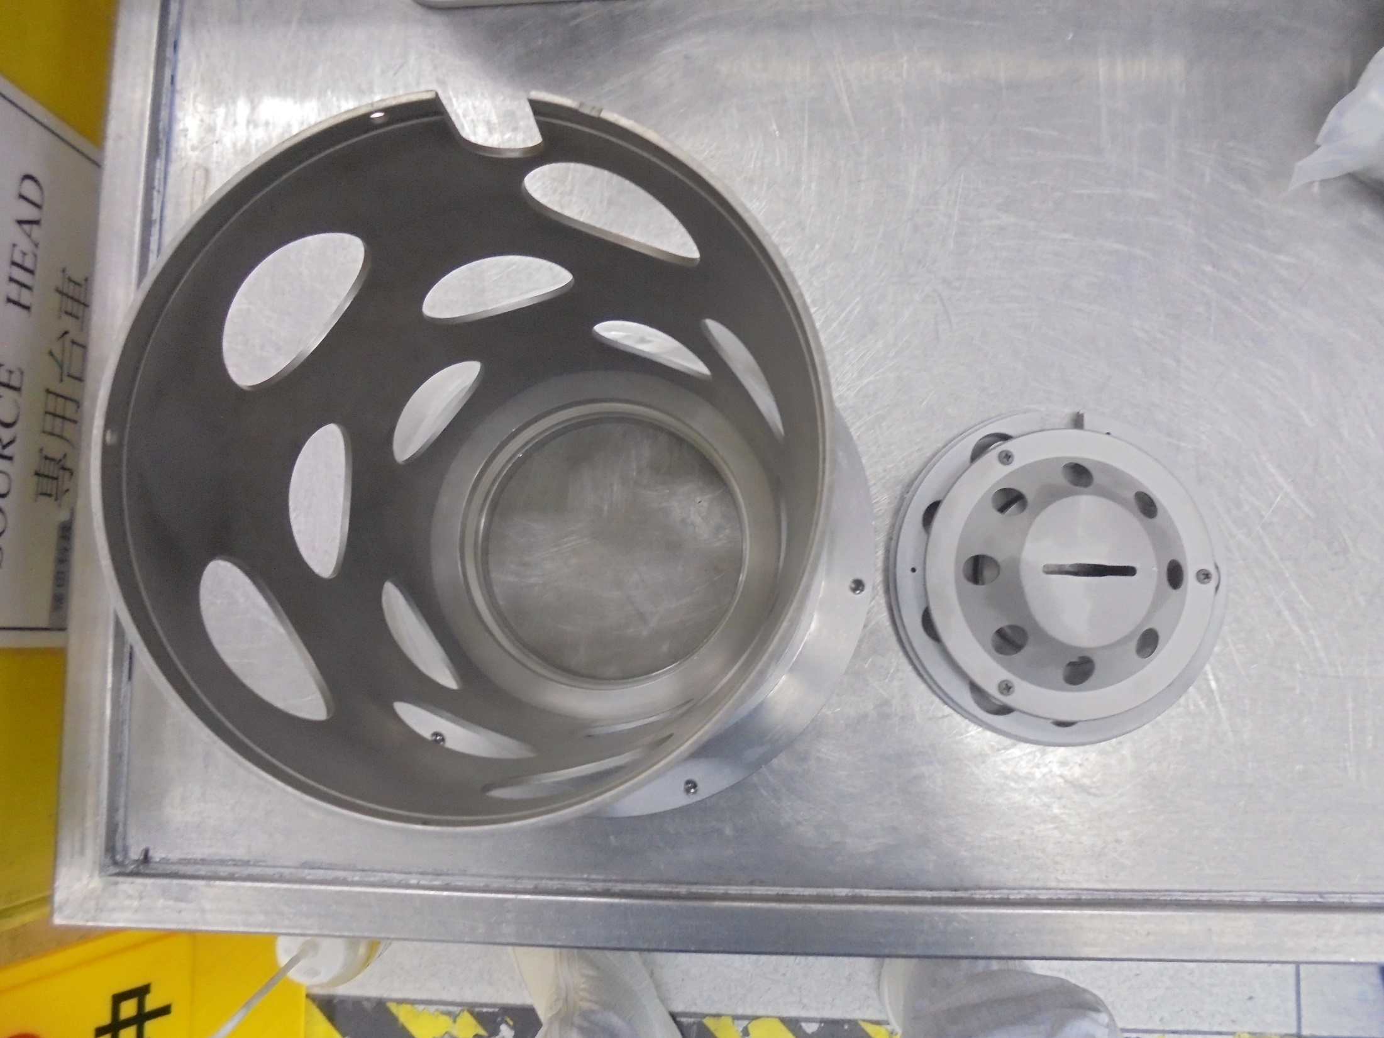
*Notice: Accel. Rod Insert slot

Slide 39
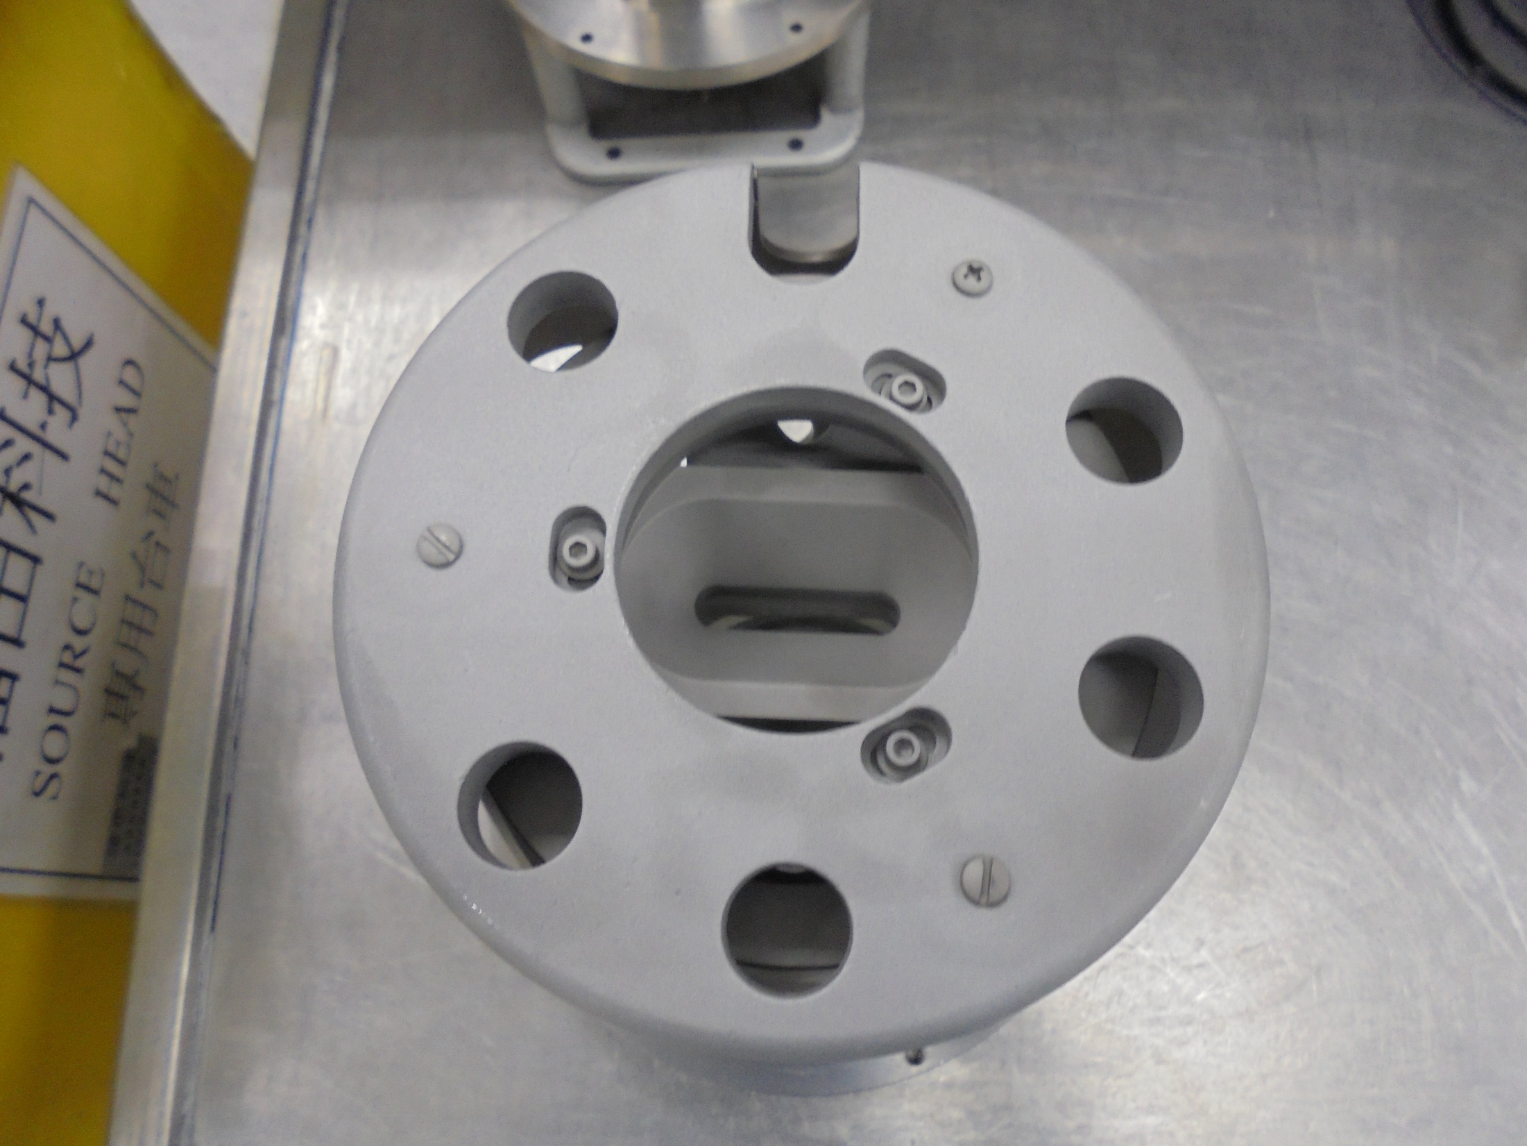
Accel. Wire Rod insert here

Slide 40
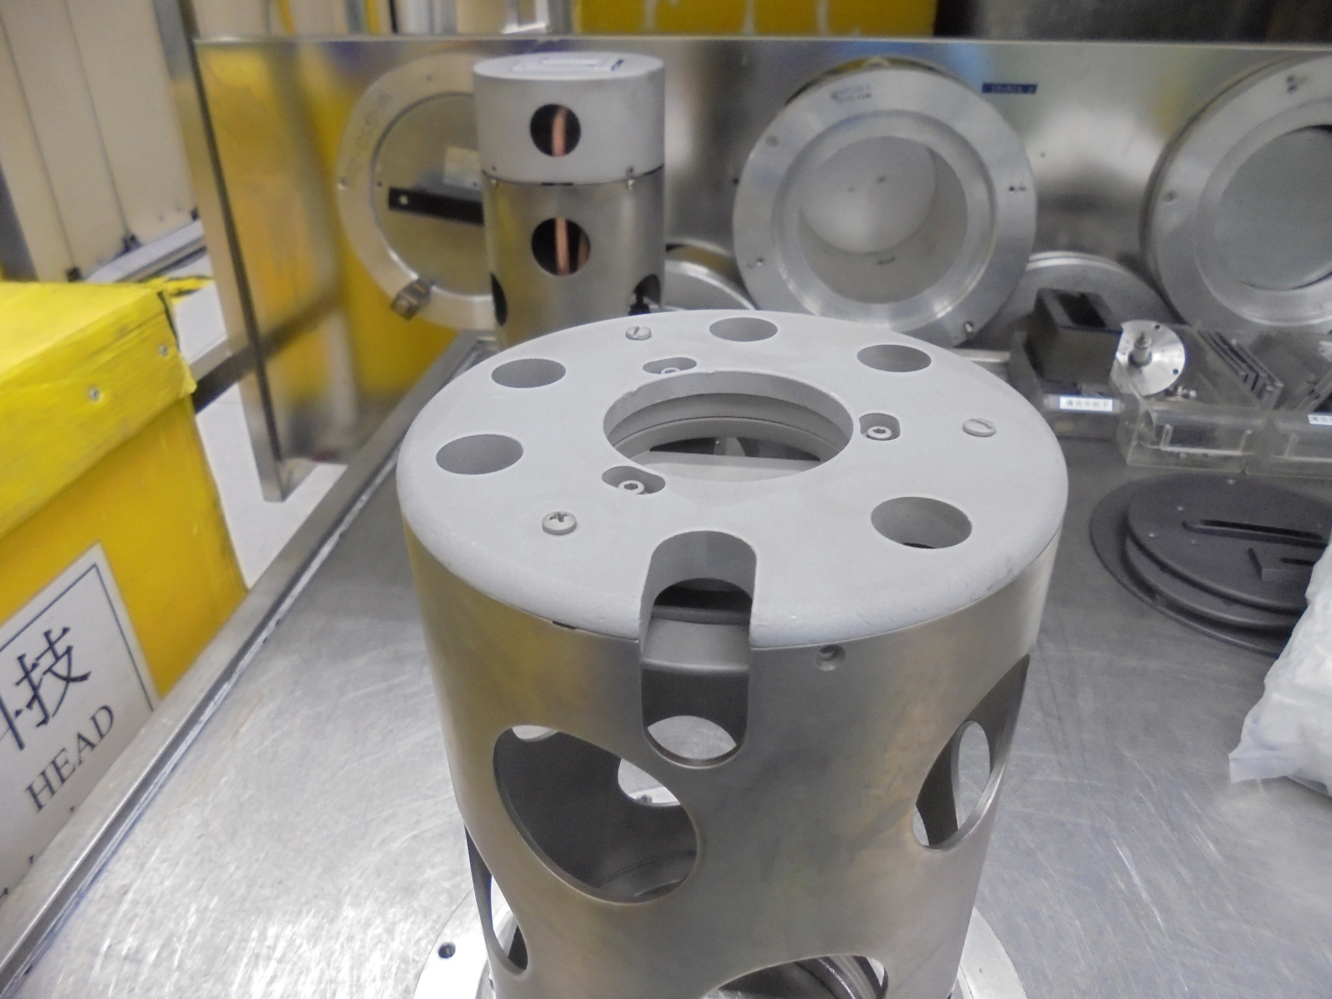
Accel. Wire Rod insert here
Secure screws

Slide 41
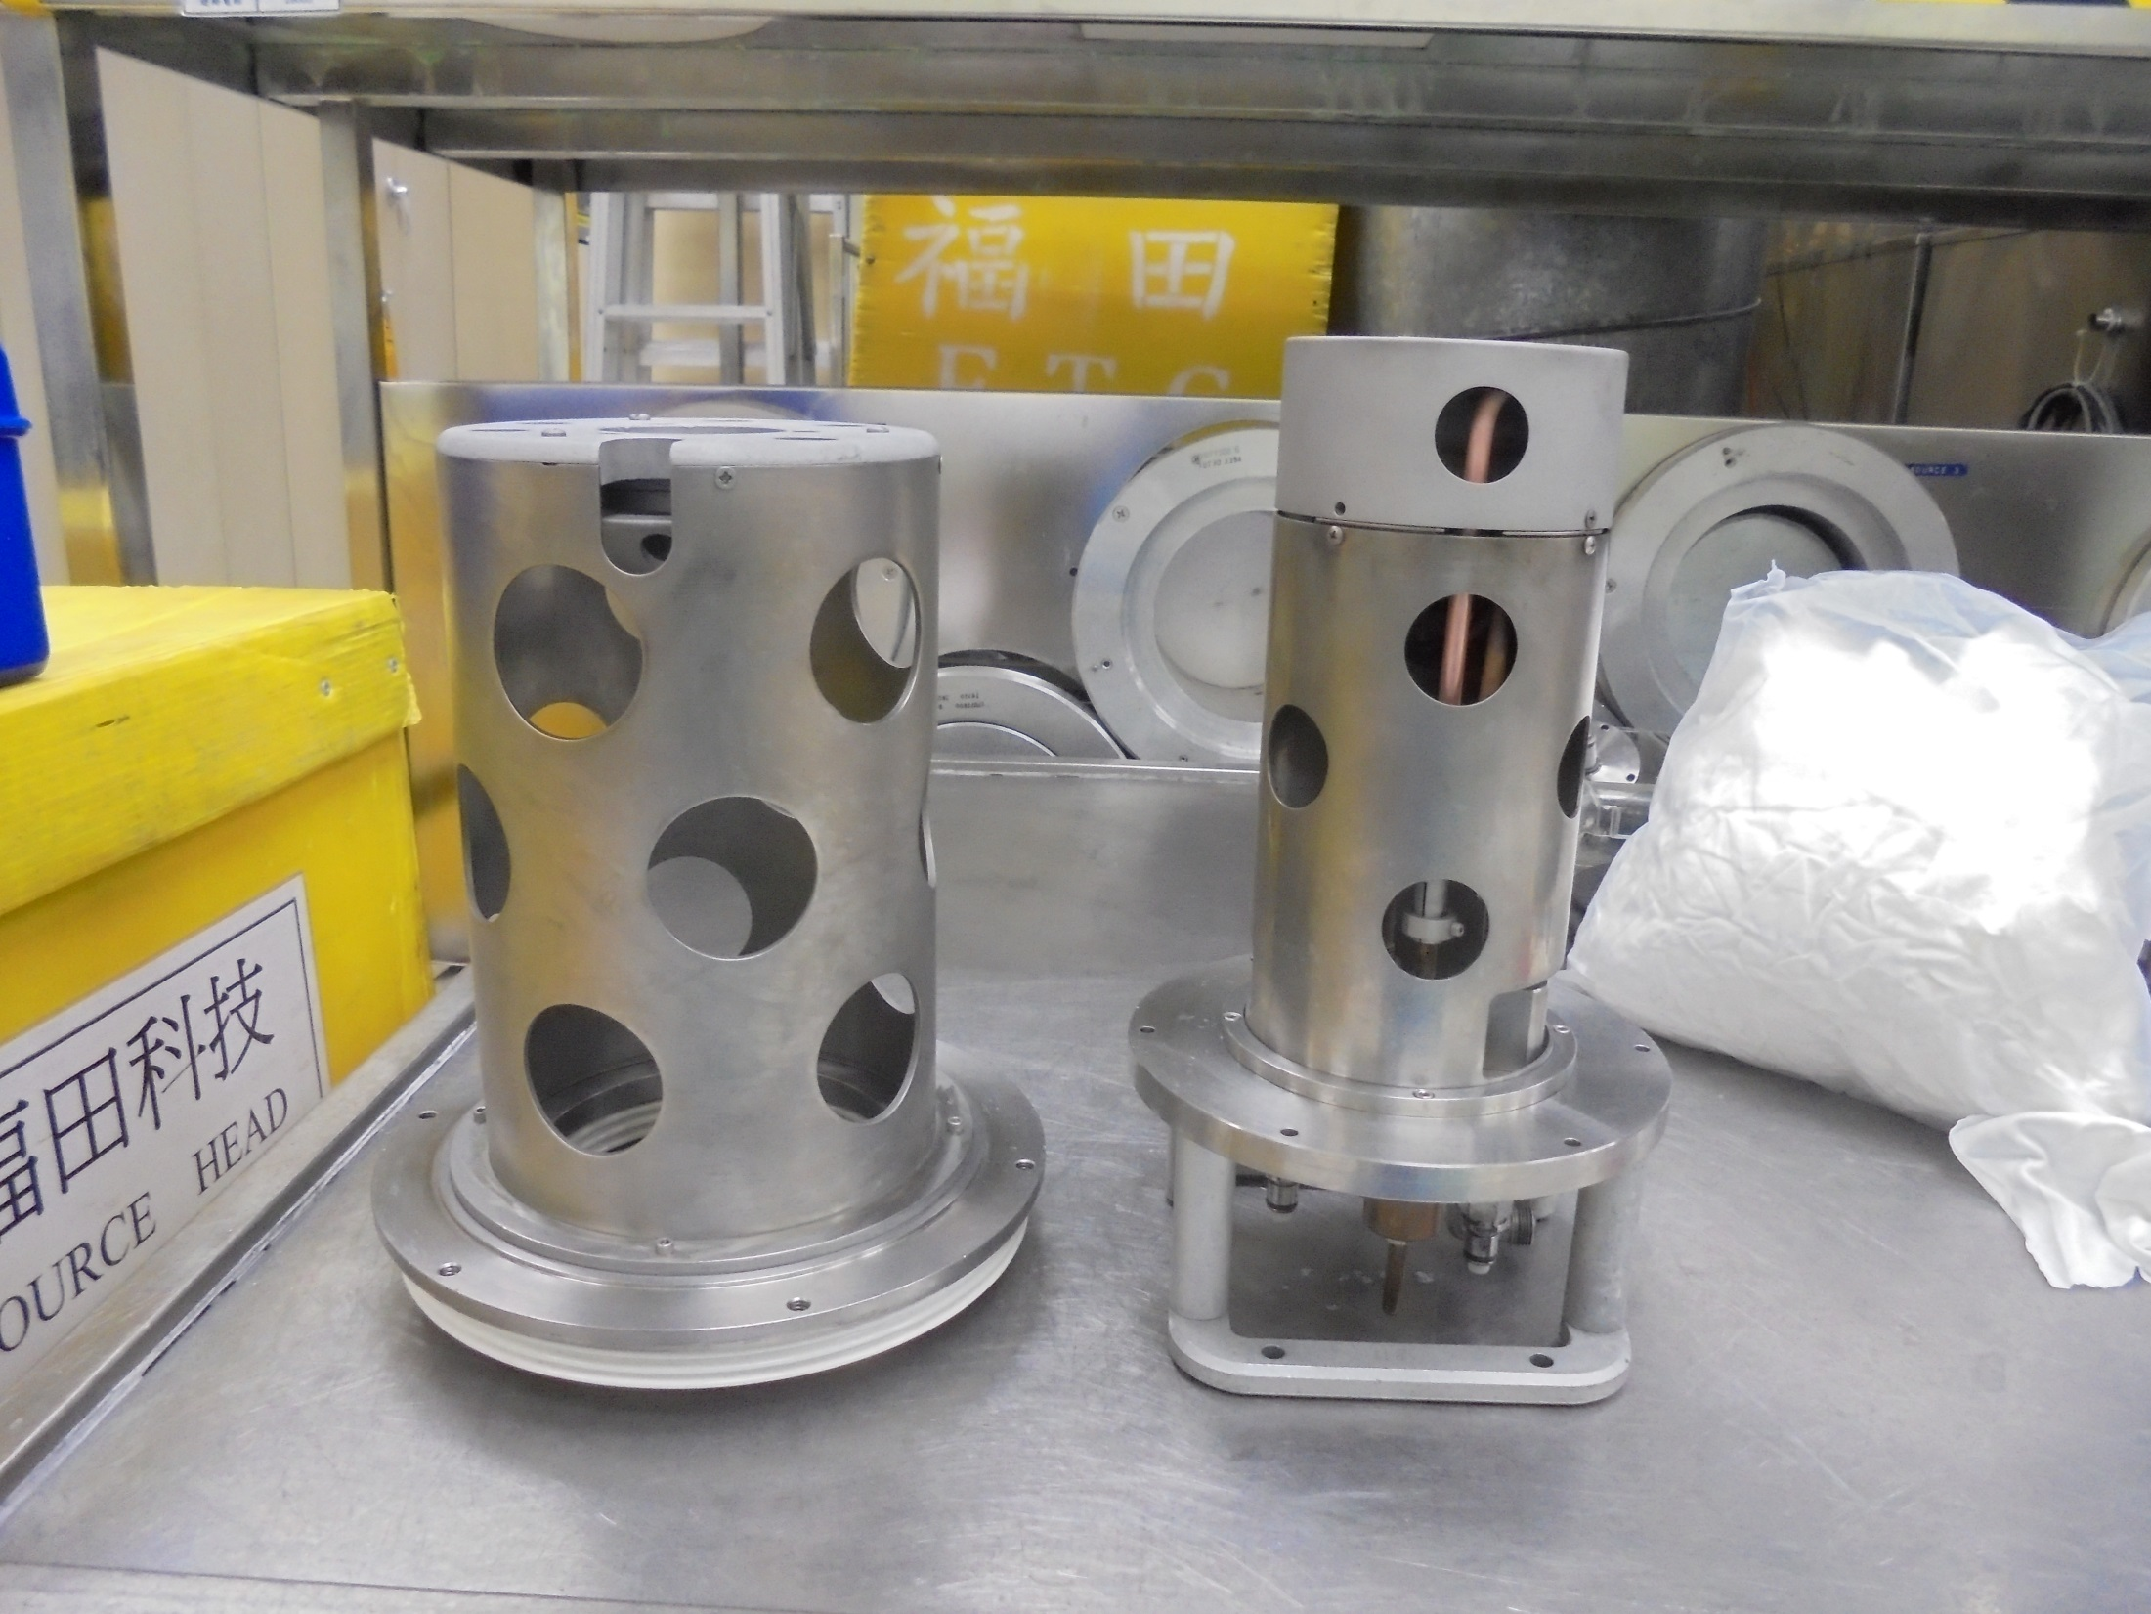
Here!
Install..
*Notice: ACCEL. WIRE ROD SLOT
*Notice: GAS LINE

Slide 42
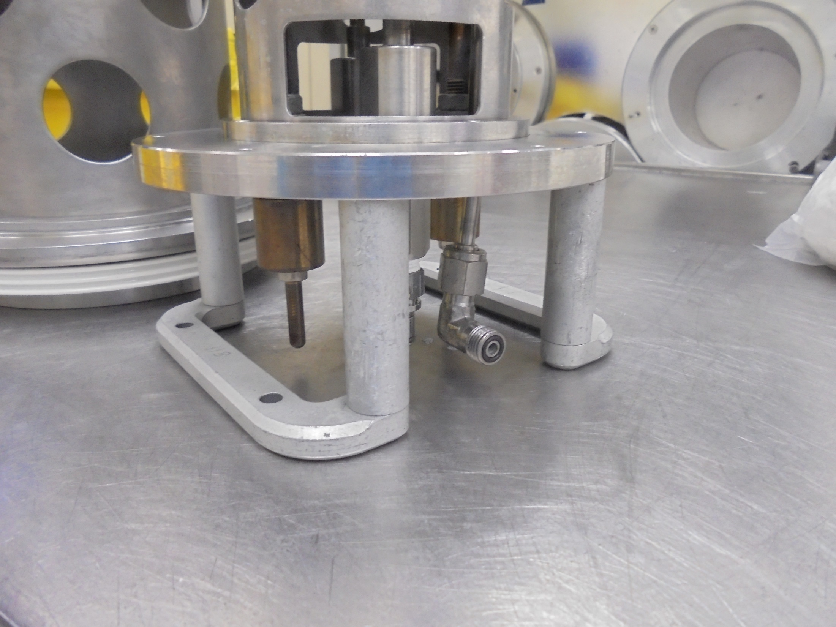
GAS LINE

Slide 43
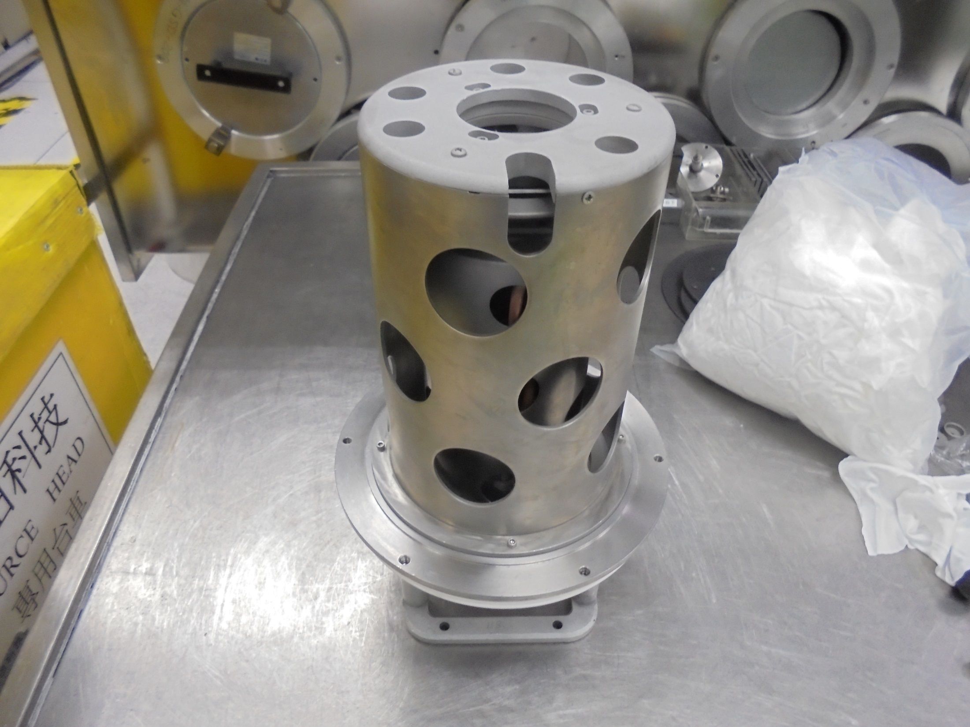
Install the Source Housing

Slide 44
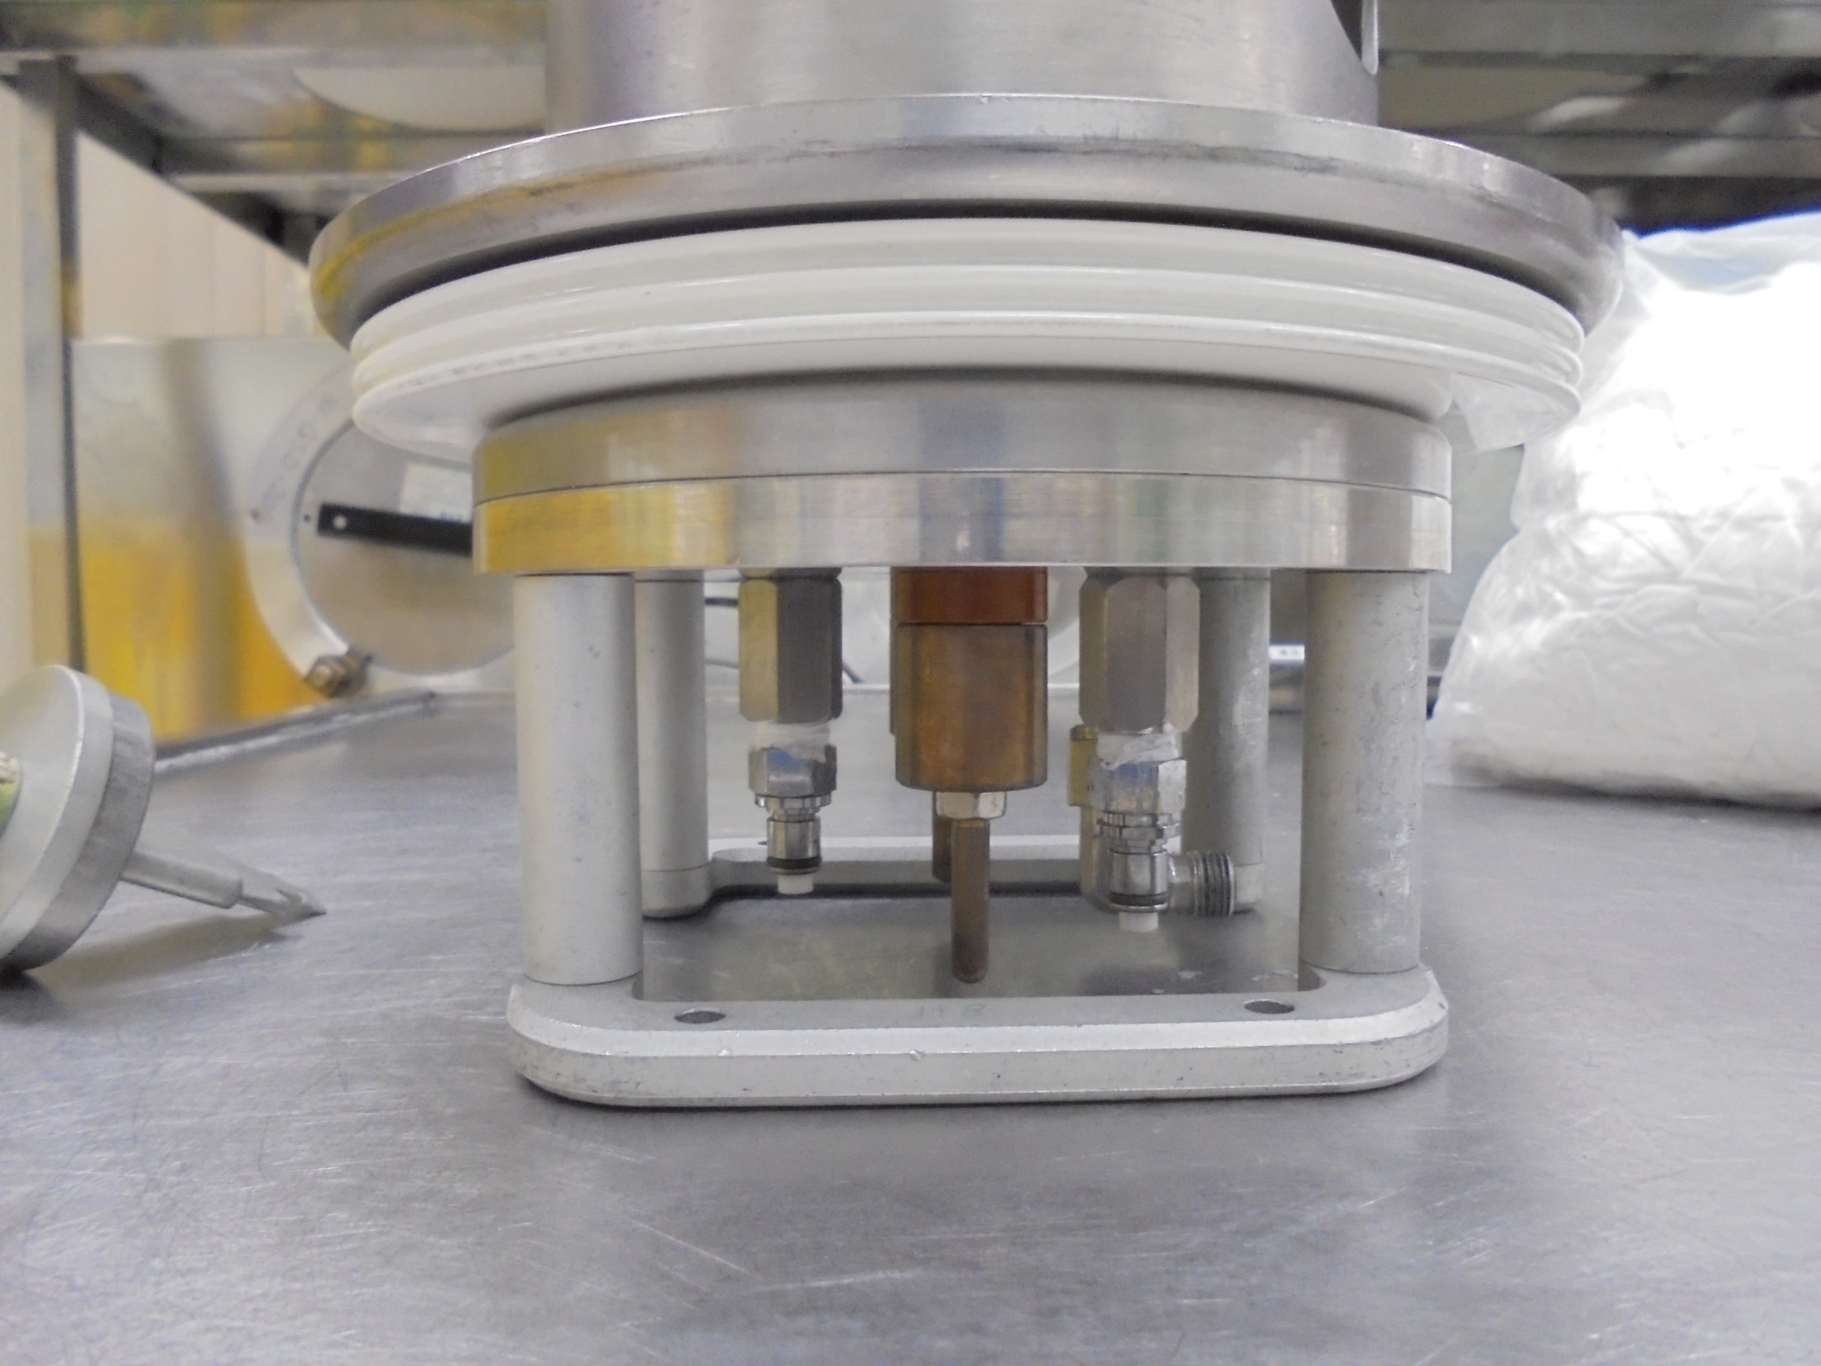
Secure some Screws on this area.

Slide 45
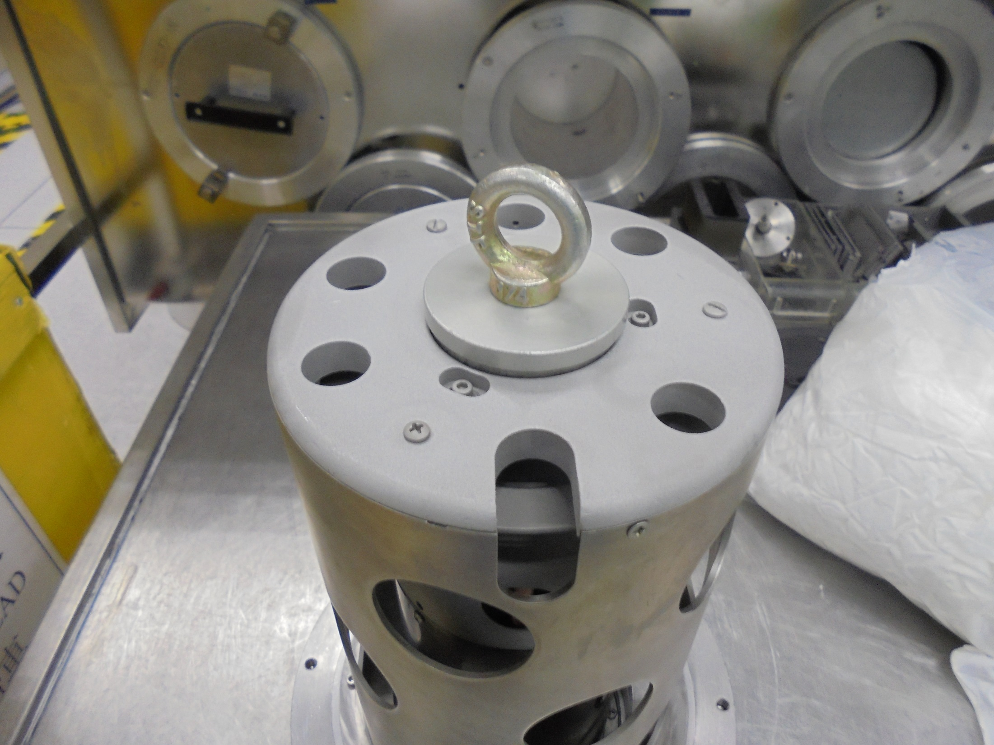
Conduct Alignment procedure between SOURCE HEAD and ELECTRODE
EXTRACTION ALIGNMENT JIG

Slide 46
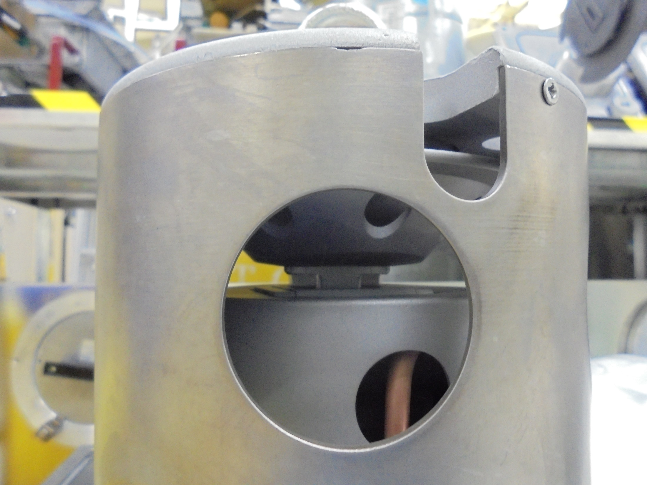
Aligning between SOURCE HEAD and ELECTRODE

Slide 47
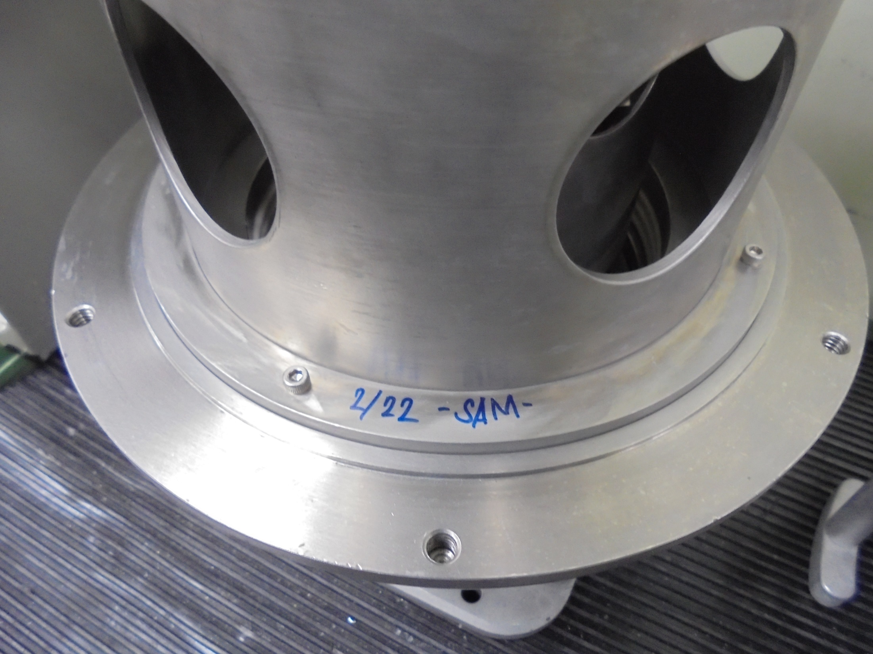
Maintenance Done. Sign Name and Date.

Slide 48
-END-

